Slide 1

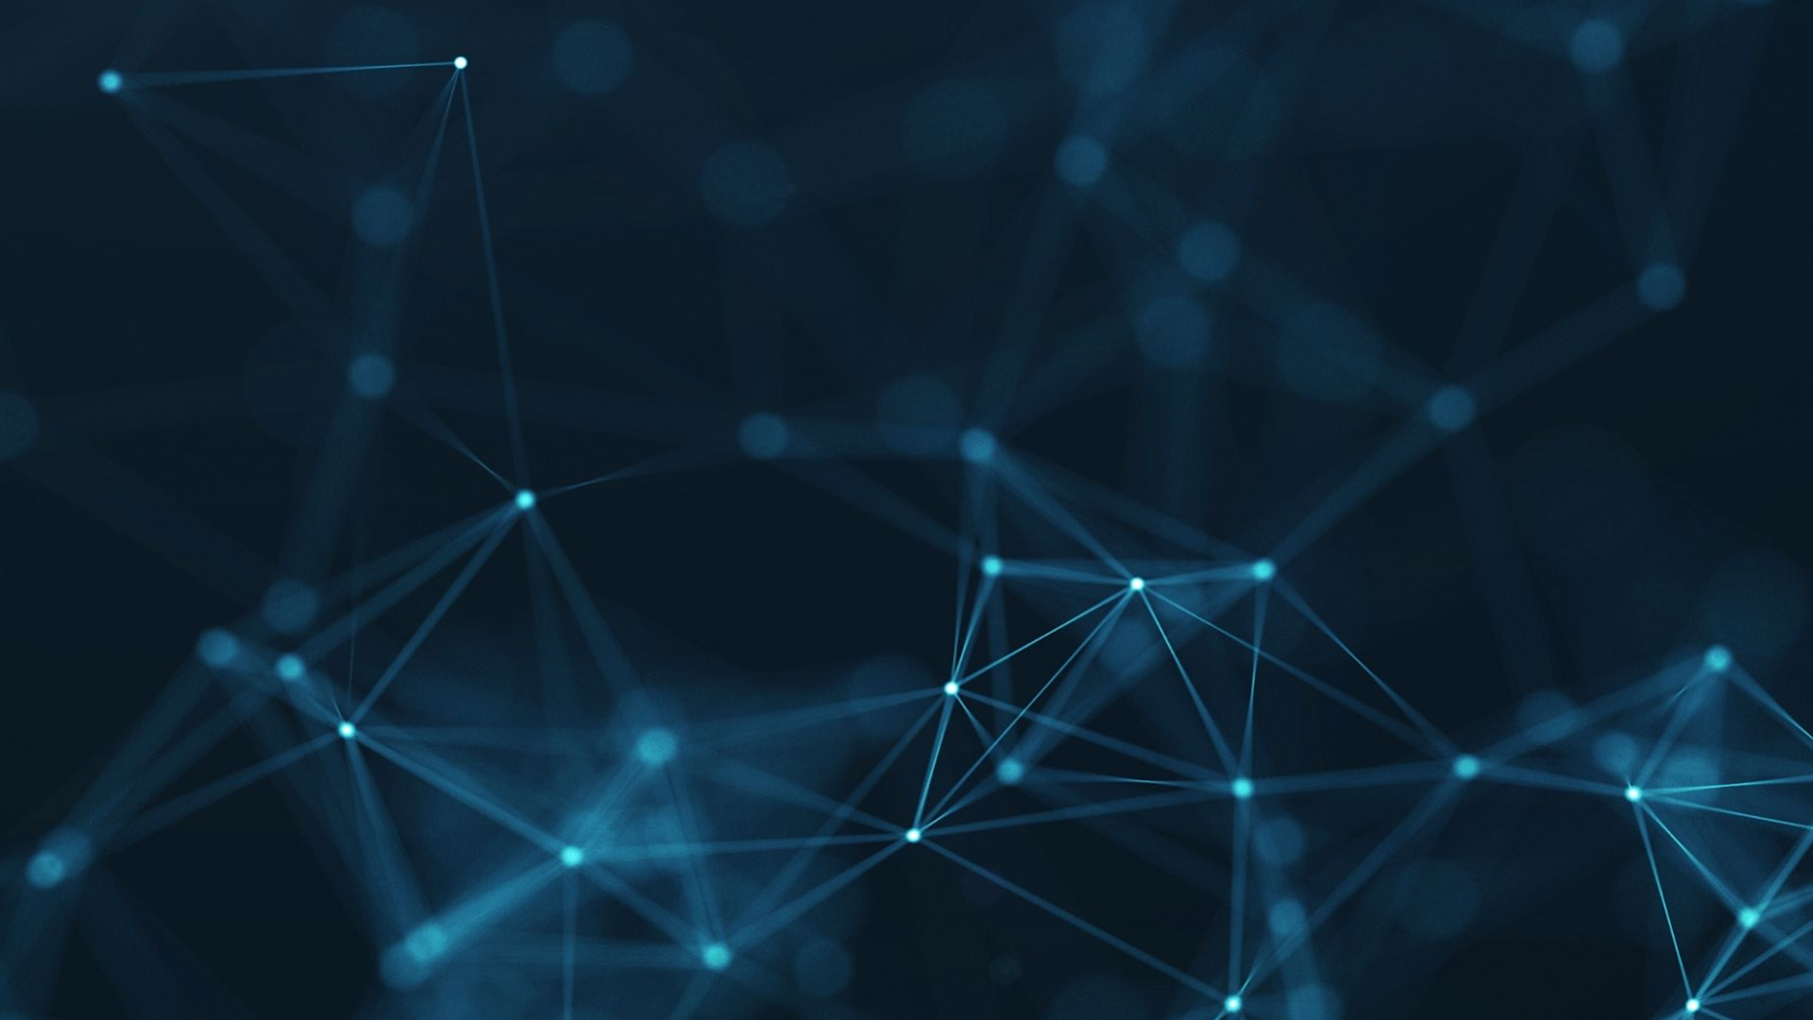

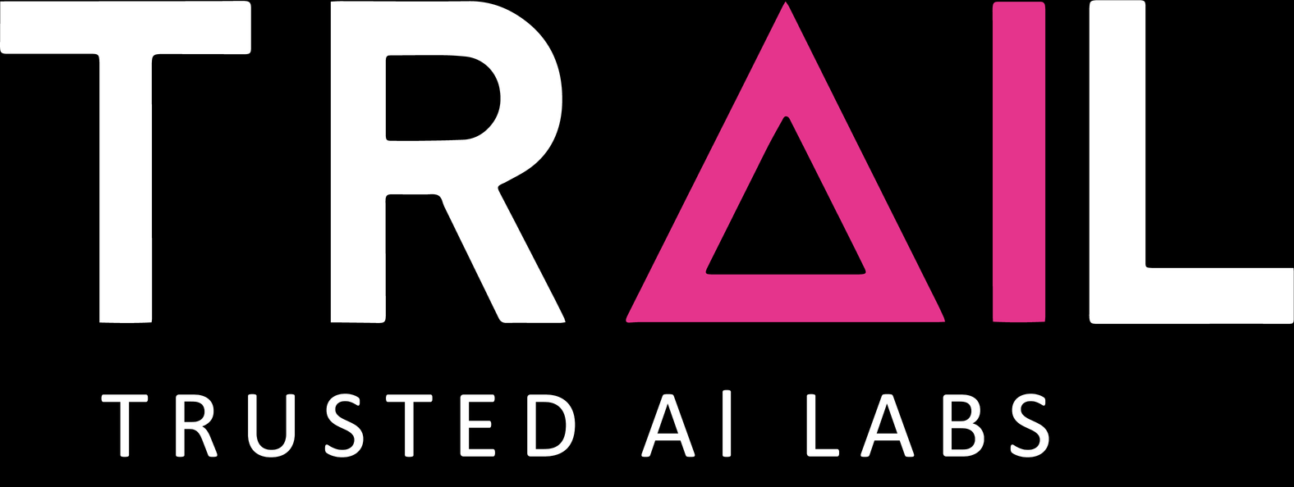
SPRING TEAMBUILDING
JUNE 8TH 2026

Slide 2


Interpretable Hybrid Modeling of Orbital Dynamics using Kolmogorov-Arnold Networks
Project n°3

Slide 3

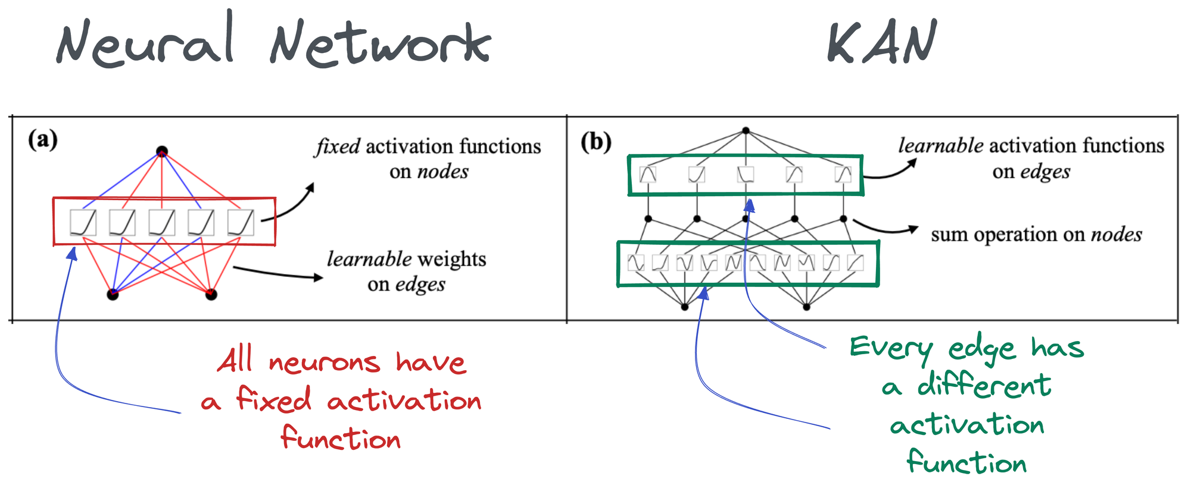
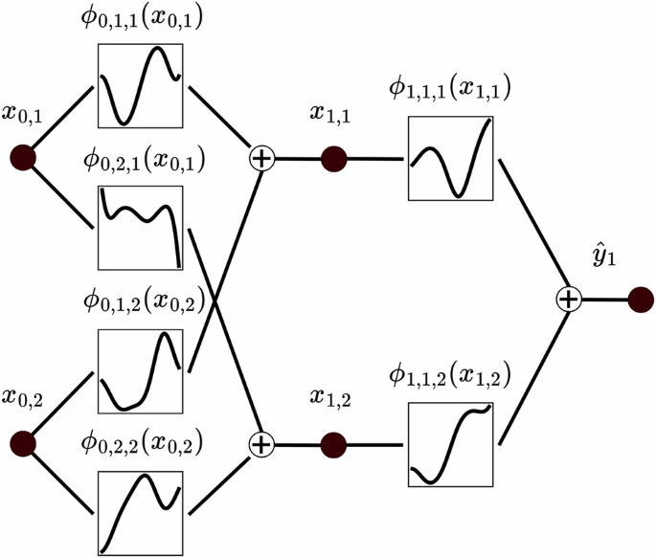







01
Context
  The project originates from newly established Kolmogorov-Arnold Networks (KANs)
  Functions are interpretable by humans and can be composed to build even more complex functions.
  Their unique property makes them suitable to learn and discover Physics Laws directly from data!
300
$x^{3}−3x+1$
$$≈$$
$$2x^{3}−3x^{2}−3x$$
$$≈$$
$$≈$$
$$x+sin⁡(3x)$$

Slide 4
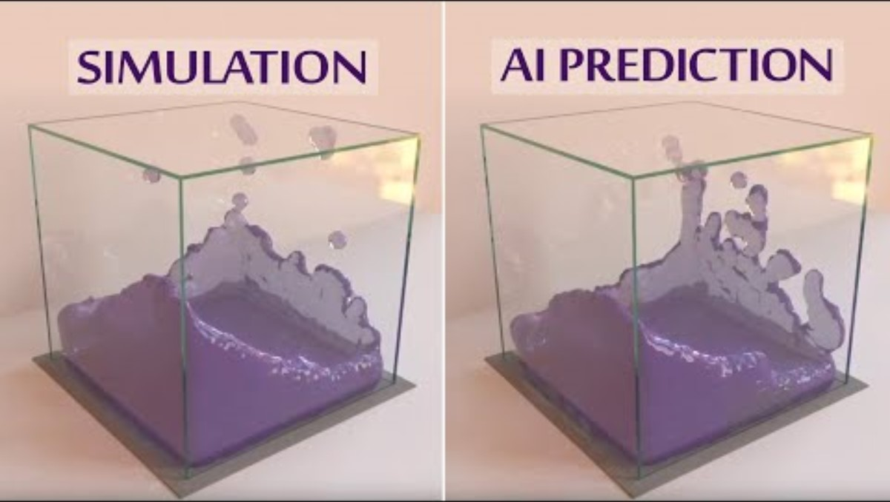
01
Context
  This brings to mind the first modeling of physical systems using AI (Google DeepMind / Microsoft)
    The goal was to predict the behavior of a system from its initial conditions
    At the time, they were using Graph Neural Networks
  2017: Physics Informed Neural Networks (PINNs)
    Require the integration of physics laws (diff. equations)
    Require humans who understand physics
    Not easily interpretable
  2024: KANs come as a new breakthrough
    Equations can be extracted from neurons (physics laws)
    Don’t need humans, only data
    Natural interpretability: each neuron is a function
300

Slide 5
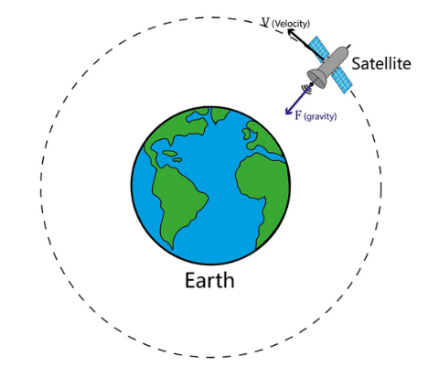

01
Context
main research
themes
  What we need: “A complex, non-linear physics-informed challenge to fully test KANs' capabilities, which at the end will deliver a framework that translates easily to similar problems .”
  What kind of problem is relevant?
    Involve differential equations (the language of physics)
    Complex functions to learn
    Incremental problem (simplifications do exist)
    We should have some expertise in the physics behind
  Ideal candidate: Orbital Mechanics
Earth's gravity
Atmosphere
Sun pressure (photons)
Earth is not a sphere
Moon and Sun gravity
Satellite thrust

Slide 6

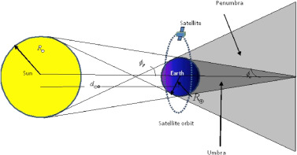

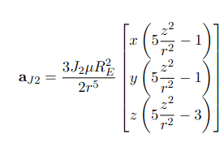
01
Context
main research
themes
  Orbital Mechanics:
  In the expressions of some perturbations, very different functions are involved.
A variety of functions are involved (area, mass, velocity, drag coefficient, atmospheric pressure)
Atmospheric pressure depends on altitude/height (h). Its models can go from a simple decreasing exponential to piecewise exponential functions.
Shade factor might be difficult to learn
Complex relationship depending on the axes (X, Y, Z)
High order terms (up to power 5)

Slide 7
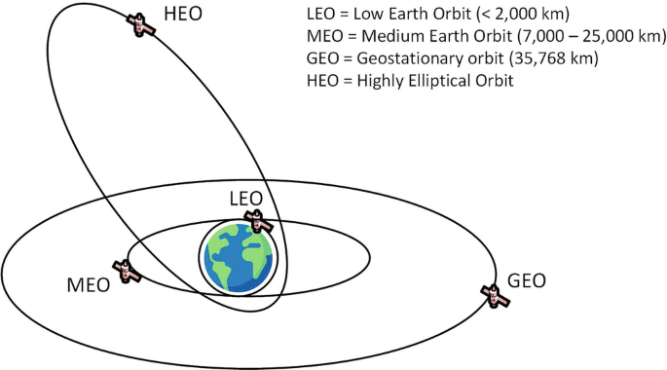
01
Context
  How are we going to learn physics?
  Research question:
  Objectives:
    Validate a homemade orbital propagator
    Build a dataset of simulated satellite trajectories
    Develop KAN-based modeling frameworks
    Analyze interpretability of learned components
Can Kolmogorov–Arnold Networks learn non-linear perturbation forces in orbital dynamics while remaining interpretable and physically consistent within a hybrid framework?

Slide 8
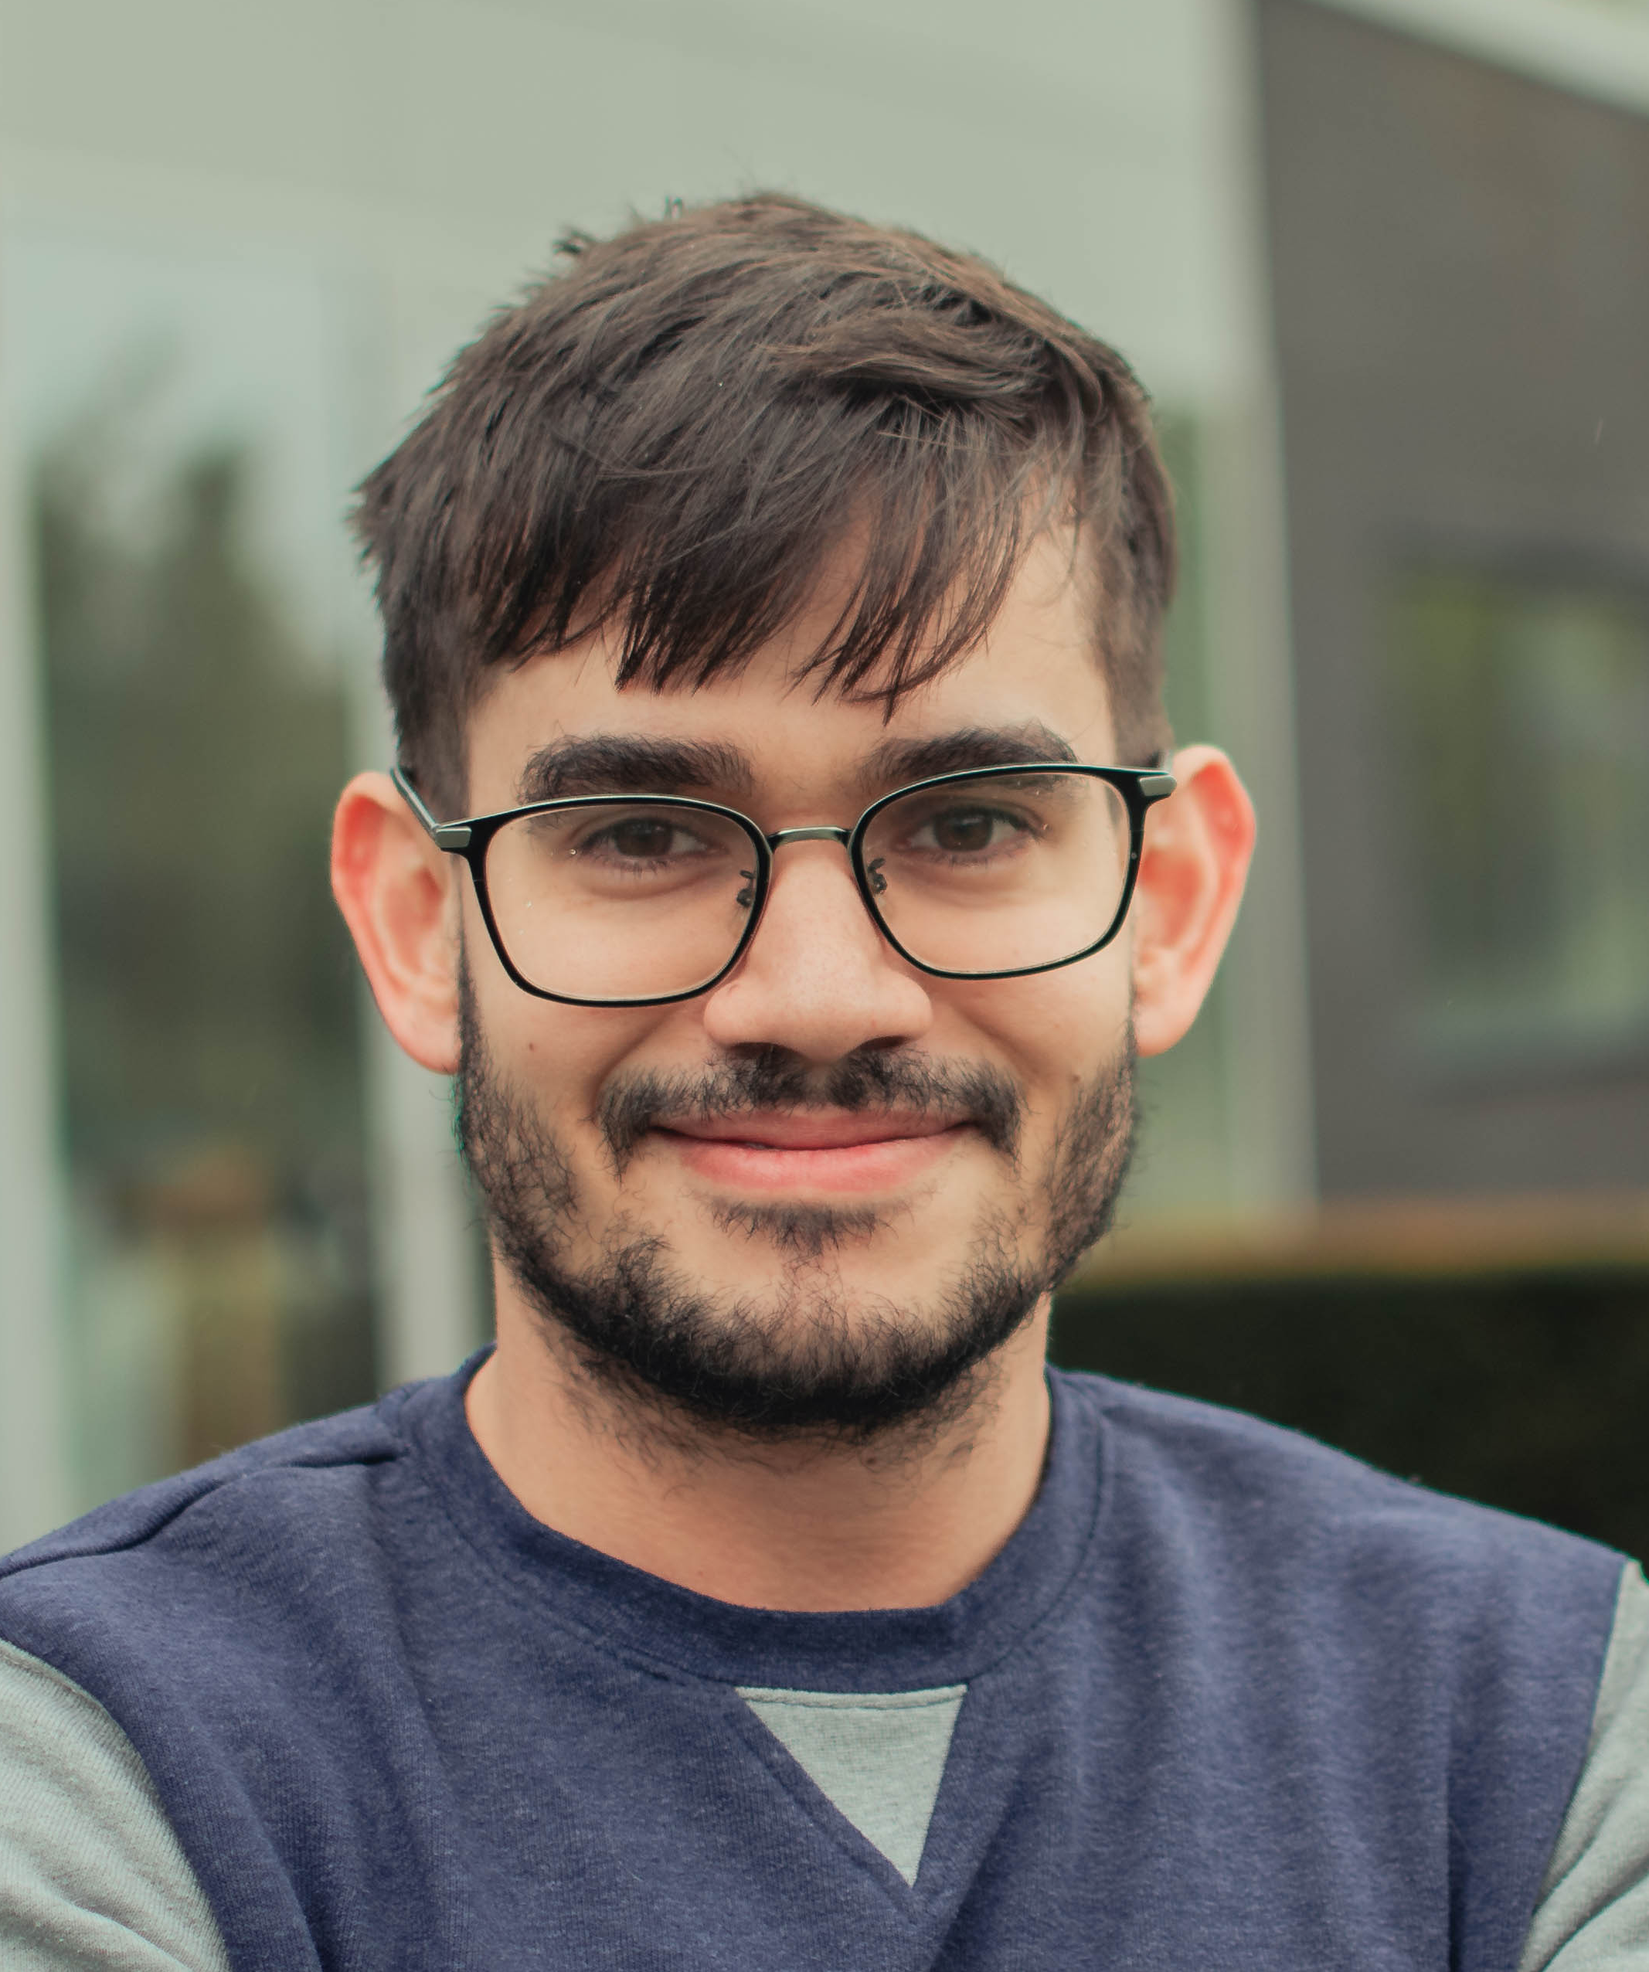
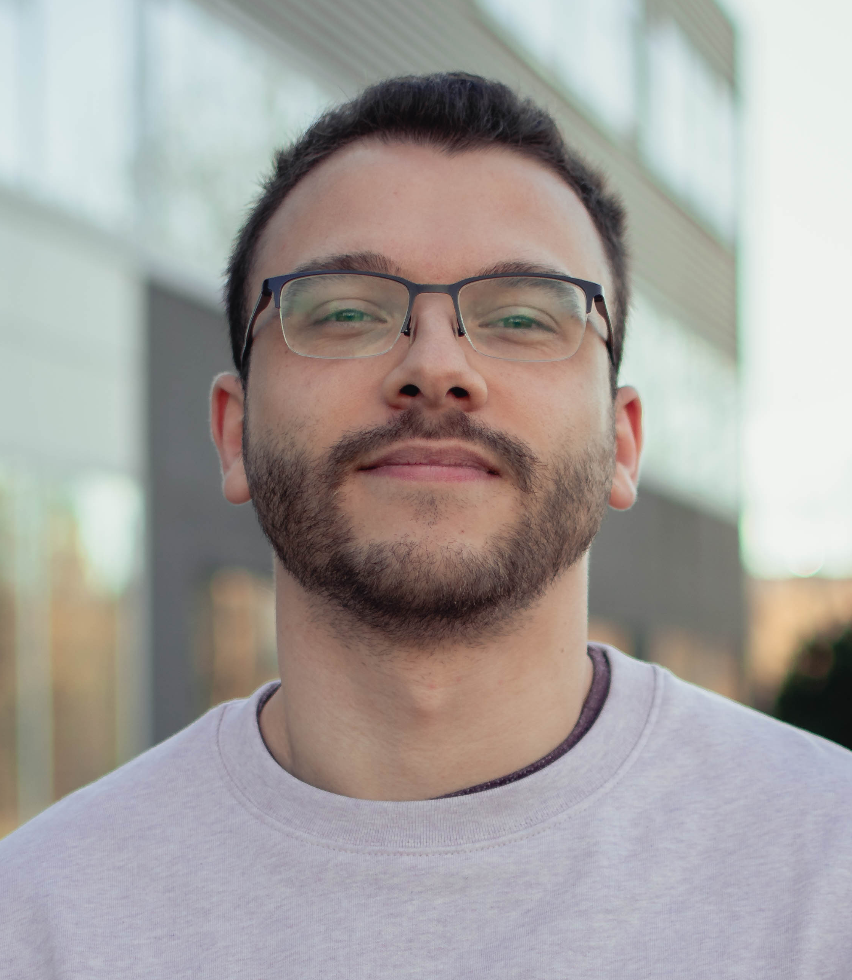
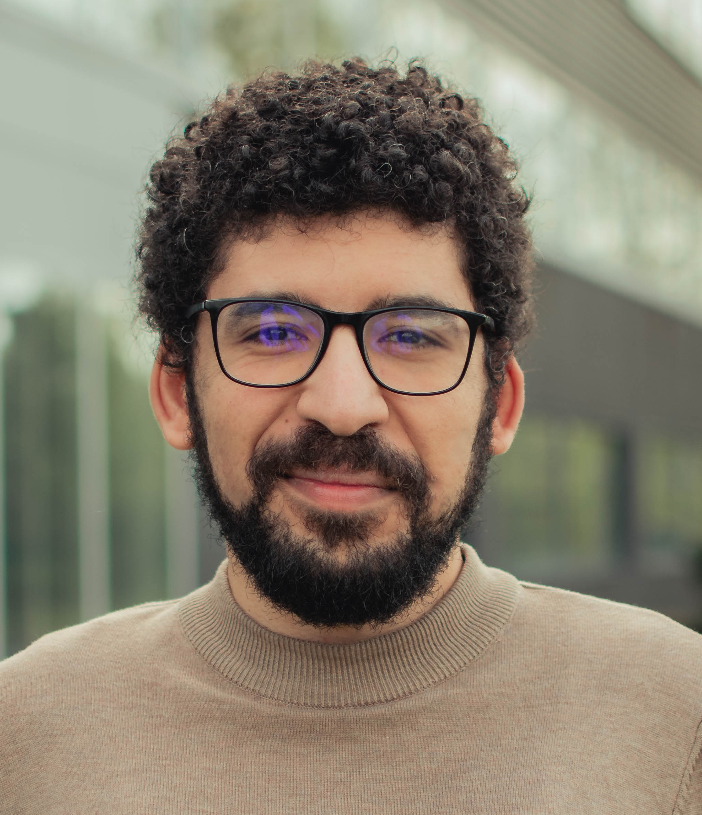
02
Founding Team
  Team Leader 1 : Horacio Tellez
    Institution: Multitel
    Expertise: Applied Mathematics, Machine Learning, Numerical differentiation
  Team Leader 2 : Vincent Boudart
    Institution: Multitel
    Expertise: Orbital mechanics, Physics, Machine Learning
  Team Member 1 : Ahmed Belgacem
    Institution: Multitel
    Expertise: Machine learning, Software Development
300

Slide 9
03
Work Plan
main research
themes
  WP1: Setup, Simulation & Baselines (Days 1-3)
    Task 1: Setup environment and repository
    Task 2: Validate the simulation pipeline
    Task 3: Generate and curate multiple datasets
    Task 4 : Train MLP baseline and initial KAN (Newtonian case)
  WP2: Residual learning & Hybrid Model (Days 3-7)
    Task 1: Compute perturbation residuals
    Task 2: Build different KANs architecture approaches
    Task 3: Integrate hybrid models
    Task 4: Initial trajectory validation
  WP3: Evaluation & Interpretability (Days 7-9)
    Task 1: Develop and apply quantitative evaluation methods
    Task 2: Generalization & Interpretability analyses
    Task 3: Auditability assessment
  WP4: Consolidation & Dissemination (Days 8-9)
    Task 1: Finalize codebase and documentation
    Task 2: Prepare report and presentation
    Task 3: Build a demonstrator
    Task 4: (bonus) Real-data validation (Hubble, ISS, Galileo, …)
Don't worry, participants will never be left alone on a single task!

Slide 10
04
Propagator Demo
main research
themes

Slide 11
05
Expertise Sought
  Machine learning / AI
    Skill 1: NN Training (PyTorch, common best practices)
    Skill 2: Architecture design (ability to criticize and bring changes to NN architectures)
    Skill 3: Evaluation methods (use/design of well-known/new methods)
  Physics / Aerospace
    Skill 1: Orbital mechanics (physical intuition, knowledge of governing forces, …)
    Skill 2: Numerical simulation & dynamical systems (experience with solving ODEs)
  Software / Data / Engineering
    Skill 1: Python
    Skill 2: Software dev (Git, common best practices, …)
    Skill 3: Data pipelines (DVC, data processing, …)
300

Slide 12
06
Join us
  If you join us, you will be able to learn:
    New frameworks/architectures (KAN-based)
    How NN can be trained on incrementally difficult problems
    How to prepare and curate simulated data for your training
    Build a visually appealing demonstrator applying the trained AI models
    Basics of orbital dynamics (how cool is this?!)
    When everything goes well (because it will): scientific publication and eternal glory
  If you want more information, please do not hesitate to contact us:
    Horacio Tellez: tellez@multitel.be
    Vincent Boudart: boudart@multitel.be
    Ahmed Belgacem: belgacem@multitel.be
300

Slide 13

06
See more !
300

Slide 14

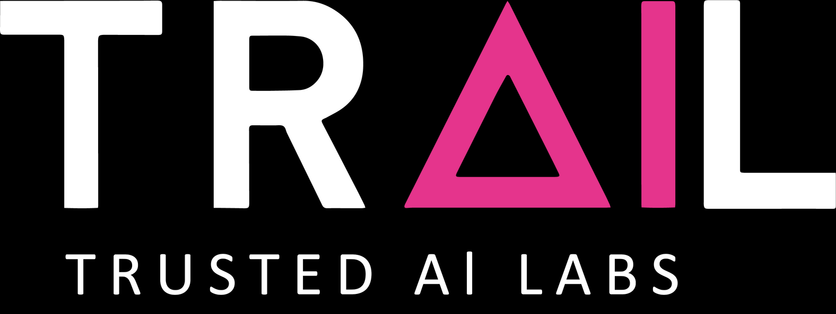
THANK YOU FOR YOUR ATTENTION !
WWW.TRAIL.AC
CONTACT@TRAIL.AC

