Slide 1




SPRING TEAMBUILDING
JUNE 8TH 2026

Slide 2



exadaps
Executable synthetic Artefacts for Data-Aware Processing at Scale
Project n°7

Slide 3


01
(a)
main research
themes
Context
300
Regulatory form filling is a major bottleneck in compliance, QA, ESG and certification workflows
Classical automation breaks on scanned forms; direct LLM/VLM filling lacks reproducibility and auditability
Our angle: treat form filling as AI-assisted program generation — a compound AI system writes a deterministic, inspectable program that fills the form

Slide 4
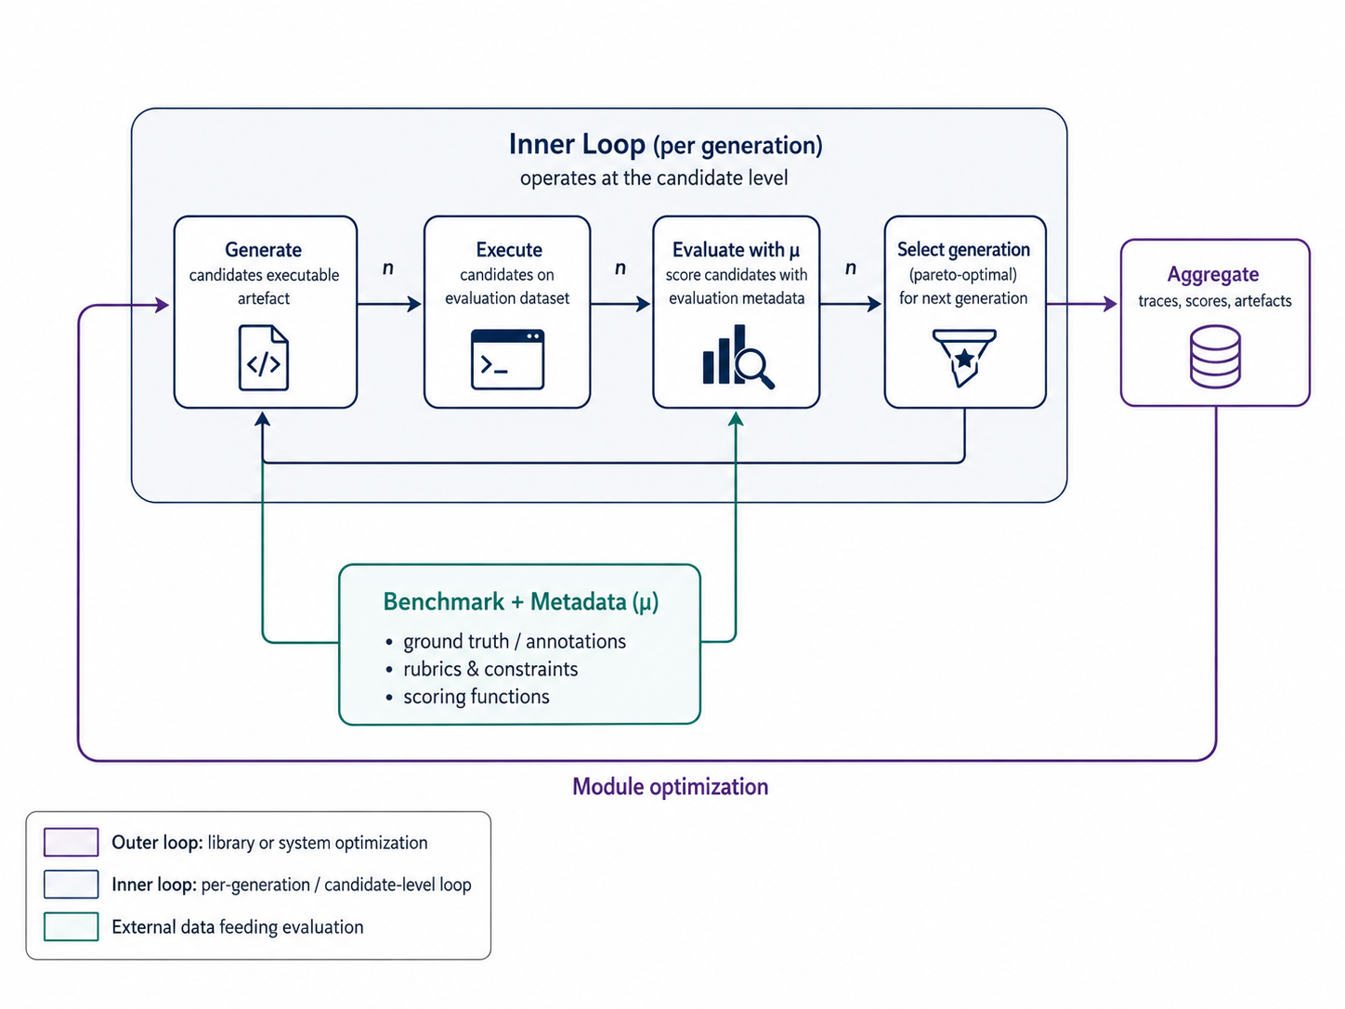
A compound AI system synthesises a deterministic, inspectable program — an evaluation function scores it and feeds failures back, improving each generation.
01
(b)
Approach

Slide 5
02
main research
themes
Founding Team
300
Michael Accetto — Team Leader
  Harness patterns as composable primitives
  Research @ DTSC BRAIN Lab — Agentic AI & regulated-document processing
  Retrieval for BNP Paribas Fortis as Senior Data Scientist;
Aditya Mukhopadhyay — Doctoral Researcher
  MSc; doctoral track on Traceform AI
  Intern @ DTSC BRAIN Lab — Document processing, Multilingual NLP
  Relevant Publication: LAMMR (Legal Adaptive Multi-model Routing, HHAI 2026 Conference),

Slide 6
03
main research
themes
Work Plan
300
Two-week Research Camp — four phases from framing to a packaged, demonstrable brick.
Days 1–3
Days 4–7
Days 8–11
Days 12–14
1
2
3
4
Framing &
baseline
Program gen
& evaluation
Self-improving
loop
Package brick
& demo

Slide 7
03
main research
themes
Deliverables
300
A reusable, open TRAIL Factory brick — usable without proprietary data.
AFF benchmark dataset
Labelled forms, knowledge maps, reference answers
Prototype harness
Generate → execute → evaluate pipeline
Baseline results
Reproducible scores across forms
Generated-program examples
Inspectable, deterministic P_{F} samples
Trace-based eval tools
Scores + failure traces for repair
Follow-up roadmap
Next steps for transferable program synthesis

Slide 8
04
main research
themes
Expertise Sought
300
We’re looking for curious builders from any background. Profiles of interest include:
Coding — Python; (resources: DSPy, GEPA, MiPROv2, Protegi)
Self-improving systems — curiousity towards self-improving systems, auditable pipeline generation, anomaly detection
Data processing — document parsing, structured/unstructured extraction, NLP or VLM pipelines, visual document understanding
Program validation — evaluation design, testing, traceability, formal or empirical correctness
Different backgrounds welcome — STEM, SSH, design, or adjacent fields.

Slide 9

THANK YOU FOR YOUR ATTENTION !
WWW.TRAIL.AC
CONTACT@TRAIL.AC

