Slide 1




SPRING TEAMBUILDING
JUNE 8TH 2026

Slide 2



When the Model Should Hesitate
Uncertainty-Aware ASR/NLP
for Early Language Disorder Screening in Children
Project n°5

Slide 3


01
Founding Team
RATENON Olivier ------
Umons
BRAECKEVELDT Bertrand
Multitel
Deep Learning
Trustworthy AI
Clinical speech
Uncertainty Estimation
NLP
LLMs

Slide 4
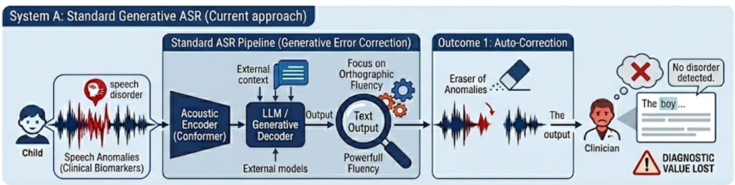
02
Context
Mistakes are information
The Generative Bias
Standard ASR forces semantic fluency over acoustic reality.
Diagnostic Erasure
"Auto-correction" actively deletes the exact speech anomalies clinicians need.

Slide 5
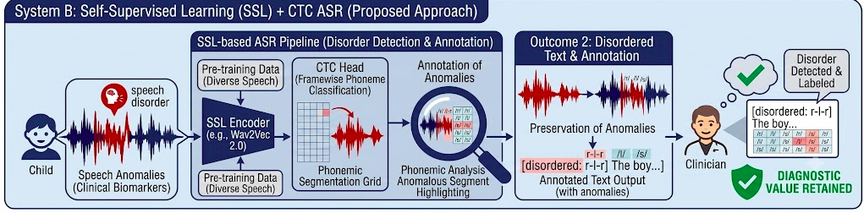
03
Context
Mistakes are information
Shift to pure classification:
Combining an acoustic encoder with a uncertainty aware classification.
Preserve diagnostic value:
Raw speech anomalies are flagged, not erased, empowering the clinician.

Slide 6
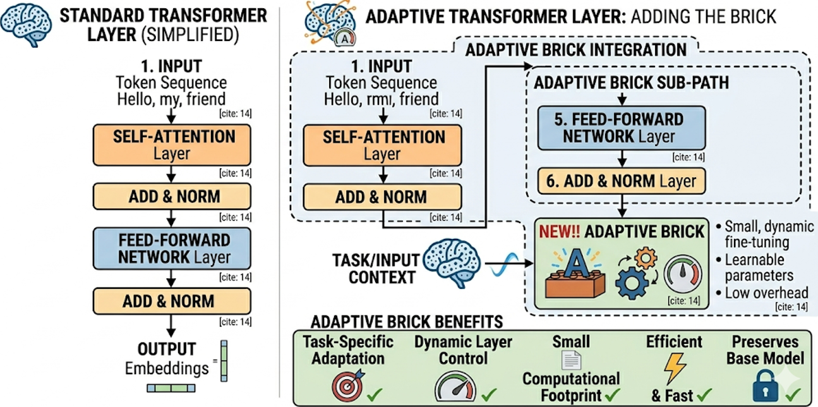
04
LoRA & Uncertainty Estimation

Slide 7
05
Work Plan
WP1
Acoustic baseline
Phoneme classifier
WP2
Uncertainty layer
LoRA-Ensemble, Laplace LoRA
WP3
Proxy validation
Child speech dataset
WP4
TRAIL Factory brick
Demonstrator
300

Slide 8
06
main research
themes
Expertise Sought
Speech / ASR
Signal Processing
End-to-end ASR
UQ / Deep Learning
Machine Learning
NLP / Computational Linguistics
Linguistic background
Phoneme error taxonomy
Clinical / Digital Health
EU AI Act Knowledge
Screening relevance
Signal classification
Acoustic mismatch
Transformers based algorithm
NLP metrics
Review thresholds
Usability
Calibration
300

Slide 9

THANK YOU FOR YOUR ATTENTION !
olivier.ratenon@umons.ac.be
WWW.TRAIL.AC
CONTACT@TRAIL.AC

