Slide 1
​Summer Workshop 25’ London
Building an Efficient Immersive Custom Environment using AI
Project n°9

Slide 2
​Summer Workshop 25’ London
Context
Work Plan
Expertise Sought

Slide 3
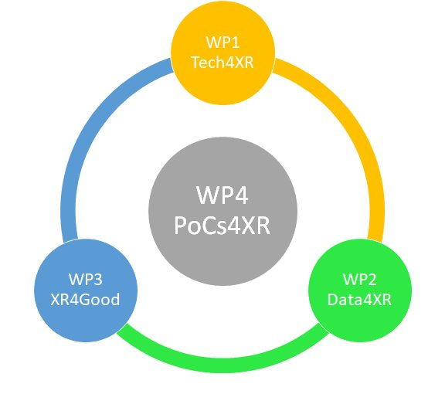
Context
Wal4XR
WP1: Technologies for interaction and immersion​
​
WP2: Data for interaction and immersion​
​
WP3: Usability challenges of XR​
​
WP4: PoCs​
​
We need tools to build virtual environments more efficiently

Slide 4
Work Plan
WP1 – 3D asset generation module:
Implementation of pre-selected image to 3D asset generation models
Development of semantic segmentation approach (most probably only on the Guassian Splatter approaches)
Benchmarking models implemented
Integration of all 3D asset generation in a single GUI
WP2 – User Mapping and Localization:
Implementation of the pre-defined localization and mapping systems
Adaptation of the systems in point three for HMD environment
Development of a benchmark for future evaluation and comparison of newly developed localization and mapping systems for HMD

Slide 5
Expertise Sought
3D Asset Generation:
Image-to-3D model architectures (e.g., NeRF, Gaussian Splatting, DreamFusion, Zero-1-to-3)
Text-to-image and multimodal (text+image)-to-image generation models
Experience with computer vision and 3D geometry
Familiarity with pre-trained model integration
Interface/GUI development
User Mapping and Localization:
AR/VR and HMD integration knowledge (e.g., OpenXR, Unity, Unreal Engine)
SLAM (Simultaneous Localization and Mapping) systems (e.g., ORB-SLAM, RTAB-Map, COLMAP)
Depth estimation, object detection, 3D object detection, 6D object pose estimation

Slide 6
​Summer Workshop 25’ London
Thank you for your attention !

