Slide 1
​Summer Workshop 25’ London
A hybrid method to assess artificial intelligence project’s sustainability with scenario modeling
Project n° 12
Notes:
OUR
A Human science project that will need your participation to collect data on the TRAIL Workshop

Slide 2
How to assesses unpredictable social and sustainable AI risk ?
Many frameworks for evaluating AI risks
Ethical: Bias, privacy, fairness
Sustainability: CO₂ footprint, energy consumption
Other Perspectives: Economic, social, legal impacts
But no framework captures the unpredictable impacts of AI
What if...?
Your model evolves in unpredictable ways
Triggers rebound effect, dual-use
Has consequences on ethics, society, work, overconsumption, unexpected economic growth…
Notes:
As we all know, AI has social and sustainable risk…
To feed the gap of the literature

Slide 3
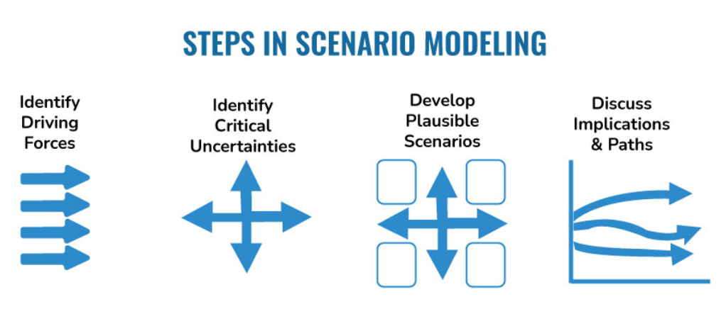
Using Scenario Modeling to predict
Sustainable Scenario Modeling is a method to evaluate environmental and social impacts when they are uncertain or difficult to anticipate
What will happen? What could happen? And how can we achieve a given objective?
Notes:
To create a new methodology using scenario modeling to predict those consequences
Sustainable scenario modeling

Slide 4
During the TRAIL Workshop
In this project, we will collect data on Your project to construct our Sustainable AI Project Assessment Framework
Interview methodology and scenarios modeling creation during the TRAIL Workshop
*See Fauré et al., 2017 : Methods for assessing future scenarios from a sustainability perspective for a review
Notes:
In an Integrative and Holistique way
Any volunteer projects

Slide 5
Work Plan
WP1 - Data Collection
Conduct qualitative and quantitative interviews with project teams from day one:
Define preliminary assessment criteria and AI specific applicability:
S-LCA: social conditions, ethical issues, stakeholder roles
LCA/SLCA: materials, energy use, emissions (if applicable)
Apply a Learning Coalition approach (Jacquemin, A., Macq, B., & Vandenbulcke, V., 2023 )to foster shared reflection and co-construction of assessment indicators

Slide 6
Work Plan
WP2 - Framework Development
Draft a simplified procedural framework for applying scenario modeling
Integrate technical, ethical, and social dimensions
Explore potential for automated scenario modeling in AI development
WP3 - Synthesis & Reporting
Conceptual findings
Method comparison
Future research axes
Prototype framework for AI sustainability assessment

Slide 7
Expertise Sought
Methodological Innovation:
Critical comparison and adaptation of assessment methods (SIA, S-LCA, SLCA, and IOA)
Design of a standardized, AI-adapted sustainability framework
Application of S-LCA to real-world AI use cases
Scenario-Based Sustainability Modeling:
Development of exploratory scenario models
Integration of technical, ethical, and social dimensions
Analysis of rebound effects and long-term sustainability trajectories
Stakeholder mapping and social risk identification
Scientific Knowledge Production:
Identification of epistemological and methodological gaps
Formulation of future research directions in AI sustainability

Slide 8
​Summer Workshop 25’ London
Thank you for your attention !

Slide 9
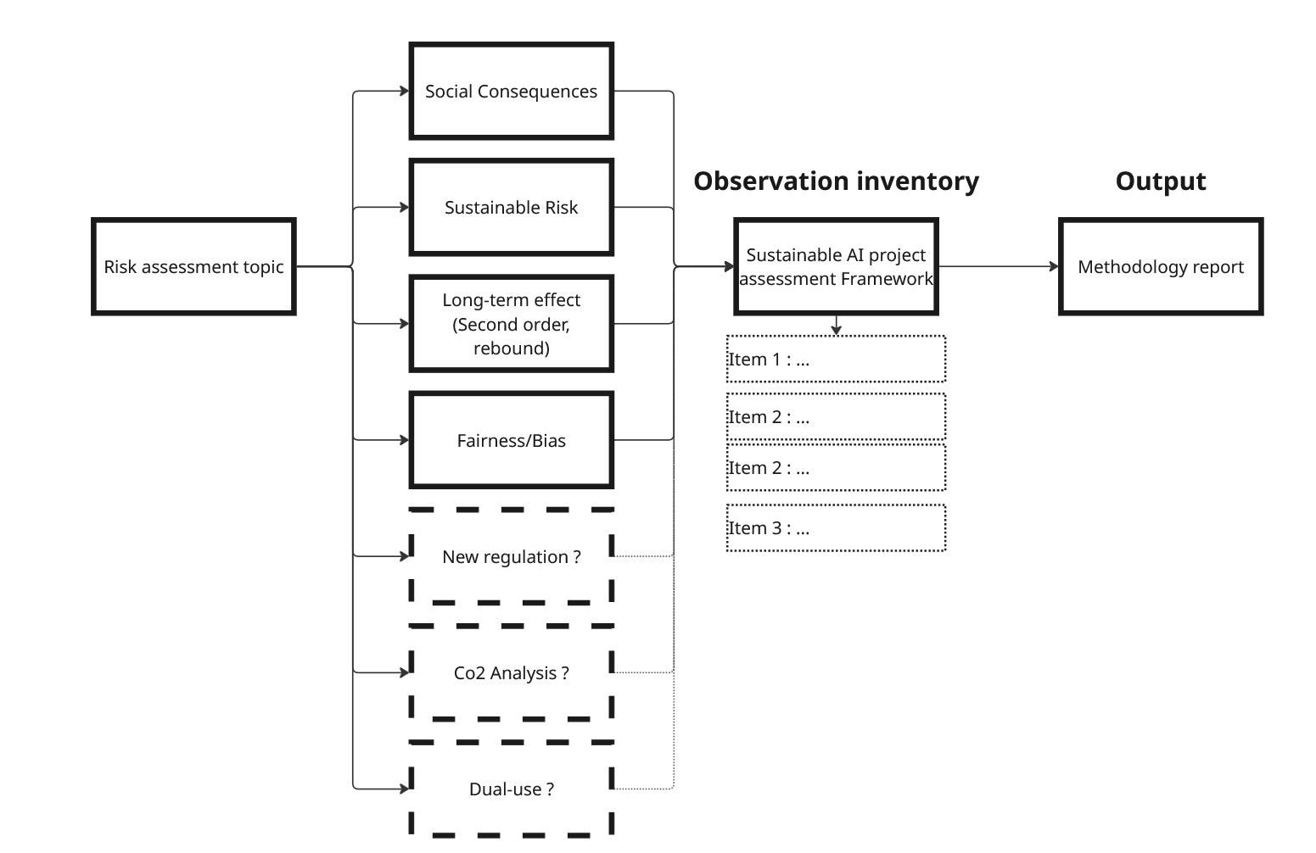
Exploring a method to create long-term scenario
Workshop goal : Developing an Innovative methodology for assessing the sustainability of AI project
Risk assessment topic of interest, possible topic integration and workshop scientific output
Notes:
A participative approach to construct a methodology to assess long term risk of AI projet
Answer the question :
Wat will be the items to ask good questions for sustainable methodology evaluation ?
What will be the indicator to assess long term risk ?
What methodology can be made to quickly scope and highlight AI application risk ?
How scenario modeling items can be materialized into sutainable and social metrics ? (eg : Co2 analysis)

