Slide 1


​Summer Workshop 25’ London
AI-based teaching for complex knowledge and communication skills (AI-Teacher)
Project n°11

Slide 2





AI in teaching
Teaching complex knowledge and communication skills with AI in Higher Education
Teaching complex content and examining learning outcomes have been important tasks for higher education
Methods such as multiple-choice questionnaires are quick & dirty and don’t measure high-order thinking
Concept maps and qualitative feedback offer better outputs, but they are resource-intensive
AI might support better teaching and examining

Slide 3
Two use cases
Use case 1 - MEDICAL:
Train medical students in communication (MI and breaking bad news)
Use LLMs with patient personas (e.g., COPD, lung cancer)
Integrate audio-visual and conceptual mapping features
Aim:
Creating valuable insights into human-AI interaction in the context of higher education

Slide 4
Two use cases
Use case 2 - EDUCATION:
BKG
OP
Achieved knowledge
MCQ
Correction time

Slide 5
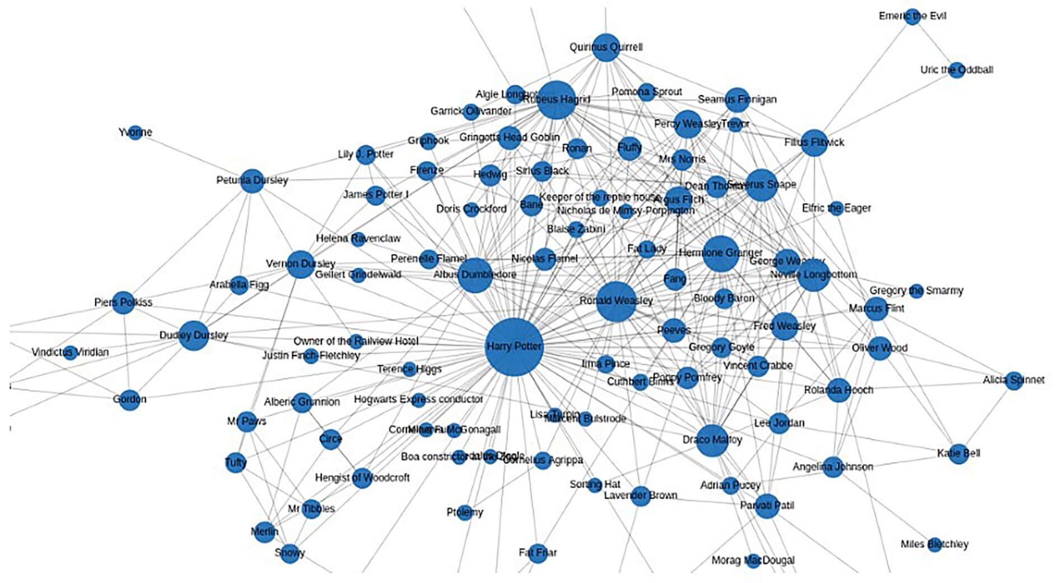
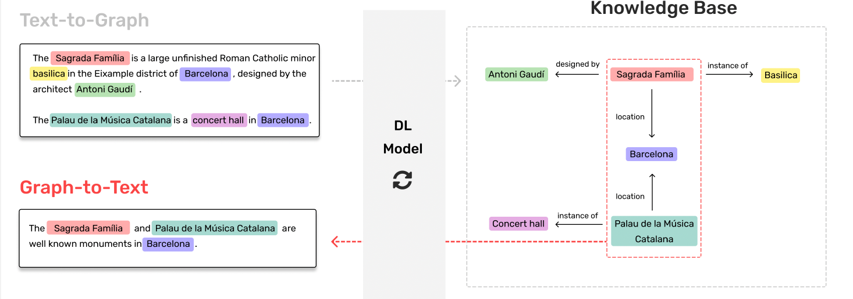
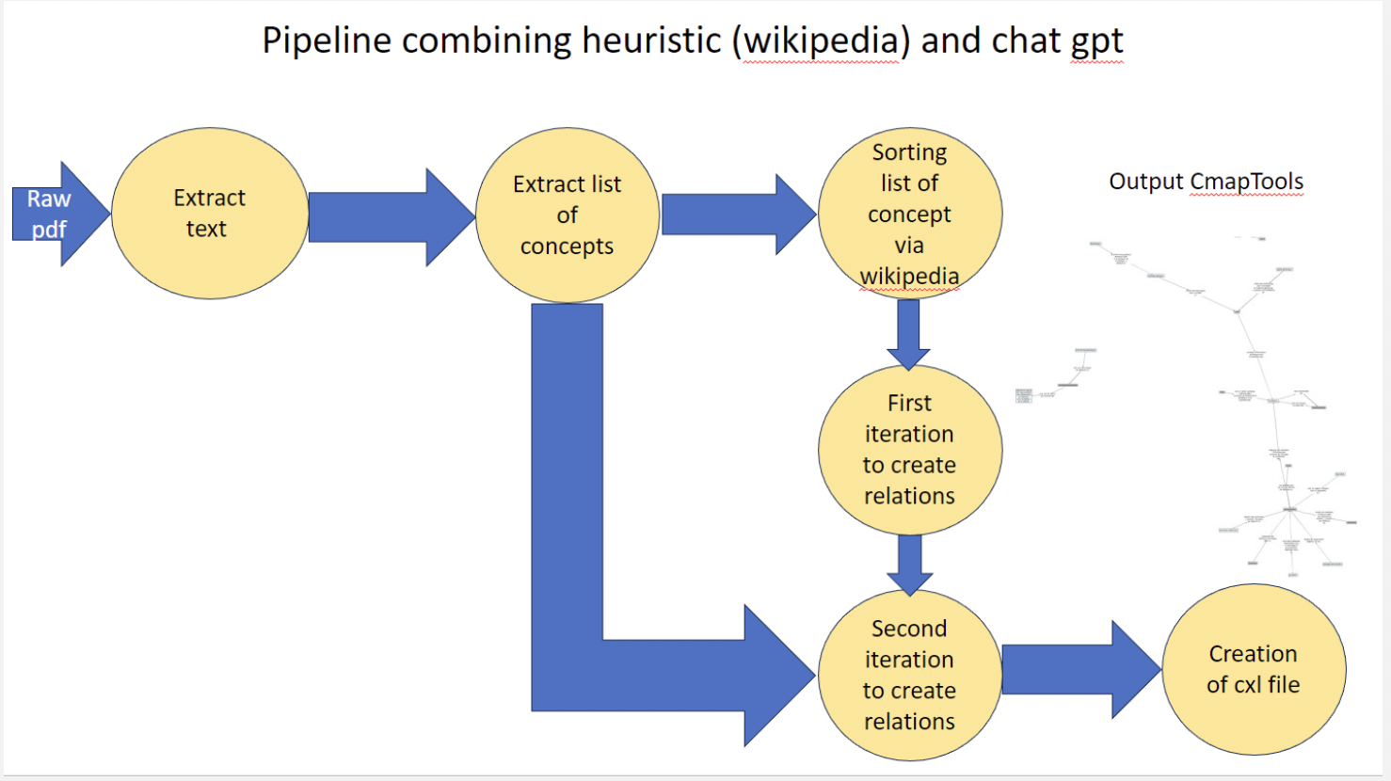
Two use cases
Use case 2 - EDUCATION:
Support science education through AI-generated concept maps
Automatically extract key concepts and relationships from academic texts
Enable interactive exercises (e.g., fill-in-the-blank concept maps)
Aim:
Creating valuable insights into human-AI interaction in the context of higher education

Slide 6
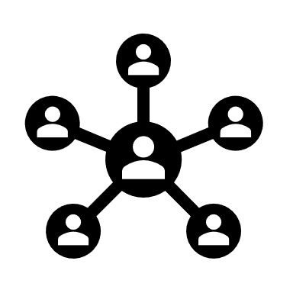



AI in teaching

Slide 7
Work Plan
WP1 - Title: Usability and efficacy analysis of LLMs
  Collect and study student interactions with GPT-based tools
  Evaluate effectiveness in teaching communication skills (e.g., MI, SPIKES)
  Capture user feedback and performance via structured datasets
WP2 - Title: Expand prompting pipeline
  Refine prompting for LLMs to simulate realistic patient interactions
  Incorporate video/audio features to increase immersion
  Use Chain-of-Thought prompting to scaffold metacognitive reasoning
WP3 - Title: Augment existing concept map assessments
  Use RAG and LLMs to generate and support CCàT (fill-in-the-blank concept maps)
  Develop tools to suggest, justify, or provide feedback on concept placement
  Link concept maps to AI for dynamic, personalized learning support

Slide 8
Expertise Sought
AI Techniques To Be Used
LLMs: Personalized conversation and communication feedback
RAG (Retrieval-Augmented Generation): Ensures grounded responses based on validated content
Chain-of-Thought Prompting: Encourages deeper student reflection
Graph-based NLP (e.g., Neo4j): Builds and manipulates concept maps
Expertise & Collaboration
Prompting & NLP: Design of robust prompting pipelines
Medical Education: Communication training expertise
Graph Tech & Pedagogy: Concept map assessment tools
Circle U Network: Supporting scalability, multilingual access, and open science

Slide 9
​Summer Workshop 25’ London
Thank you for your attention !

