Slide 1
​Summer Workshop 25’ London
Adapting foundational vision models to instance segmentation and data quality assessment with few annotations: application in histopathology.
Project n°1
Clément Fuchs¹ – Benoît Gérin¹ – Maxence Wynen¹– Laura Jimenez² – Arthur Lefebvre³
1: UCLouvain ; 2: ULB ; 3: Imperial College London

Slide 2
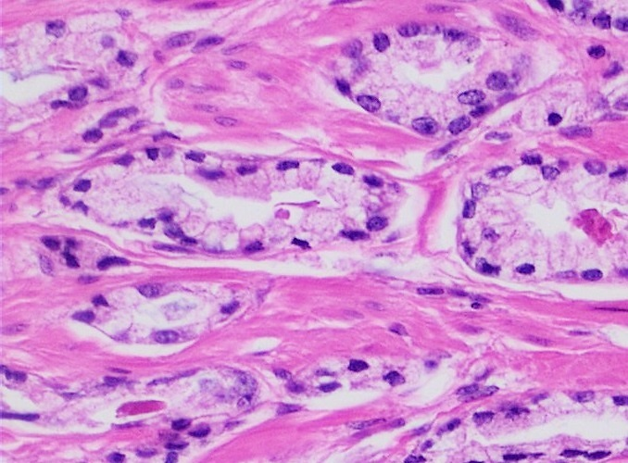
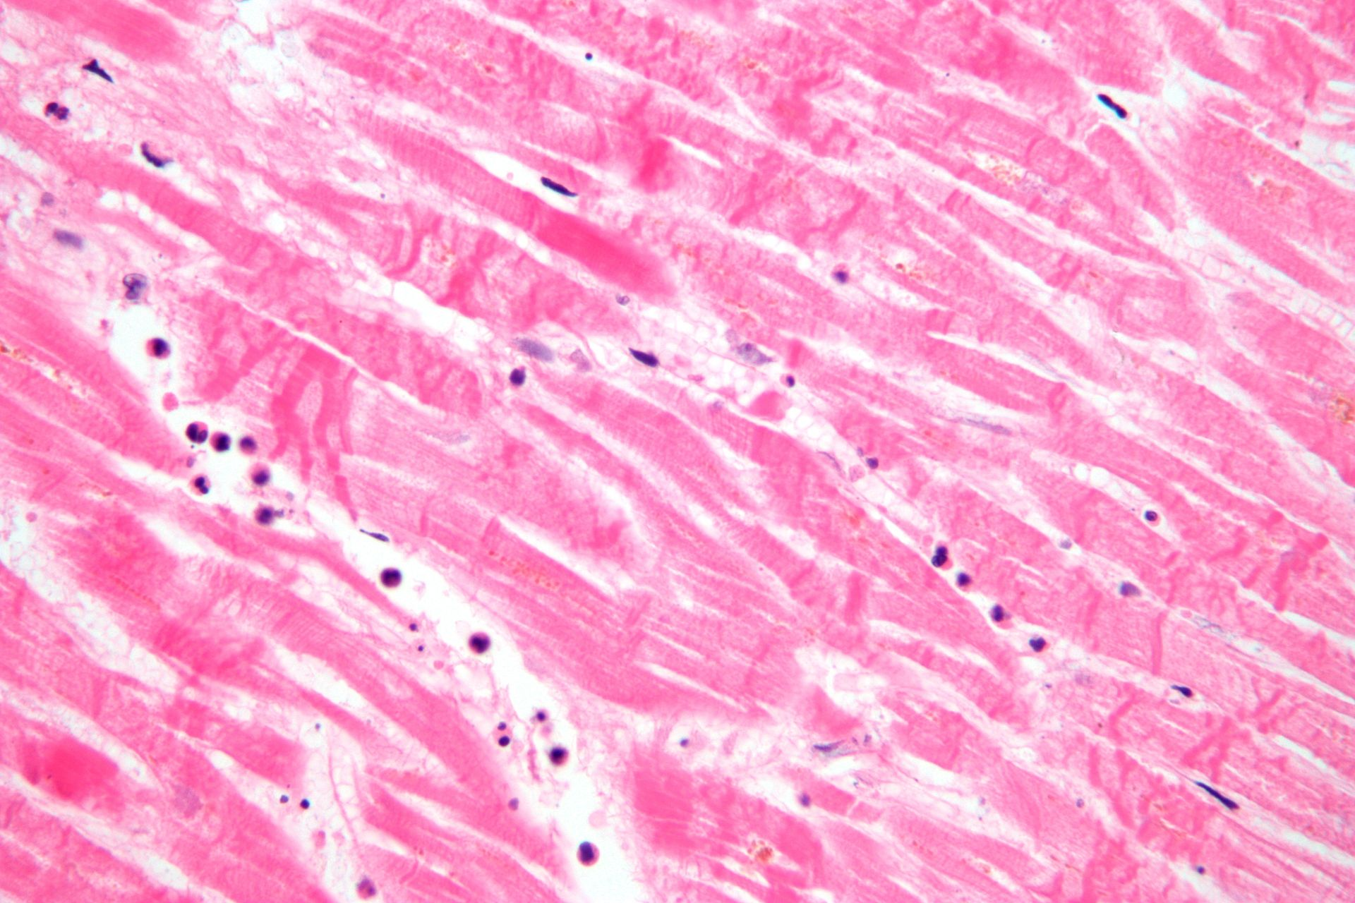
Adapting foundational vision models to instance segmentation and data quality assessment with few annotations: application in histopathology.
What is histopathology ?
Examples taken from Wikipedia [1].
Large images (~100k X 100k pixels)

Slide 3
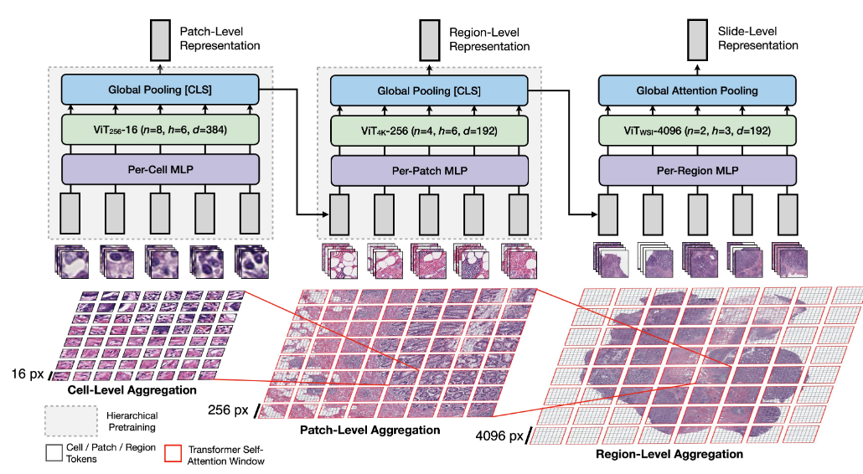
Adapting foundational vision models to instance segmentation and data quality assessment with few annotations: application in histopathology.
“Foundational Models” for histopathology
Typical downstream tasks:
Patch / Slide classification
Survival prediction
Semantic segmentation
More recently, instance segmentation
HIPT [2], a foundational model for histopathology. The encoders are trained in a self-supervised manner using the DINO method. Note how the model can encode patches at different scales. Figure taken from [2].
Pre-training using data without annotations (~10⁵ – 10⁹ patches)

Slide 4
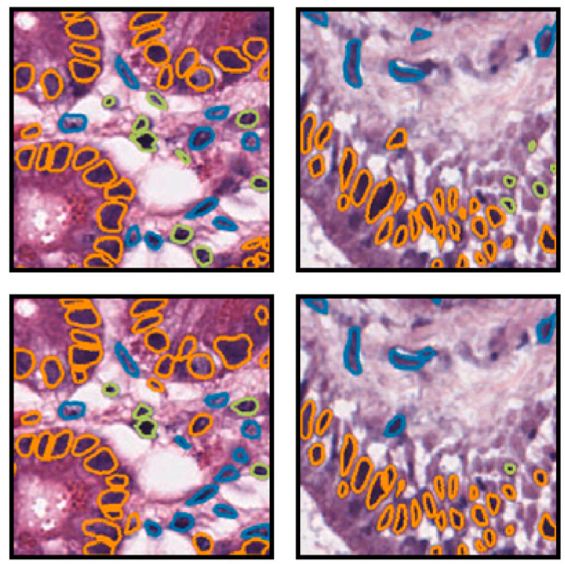
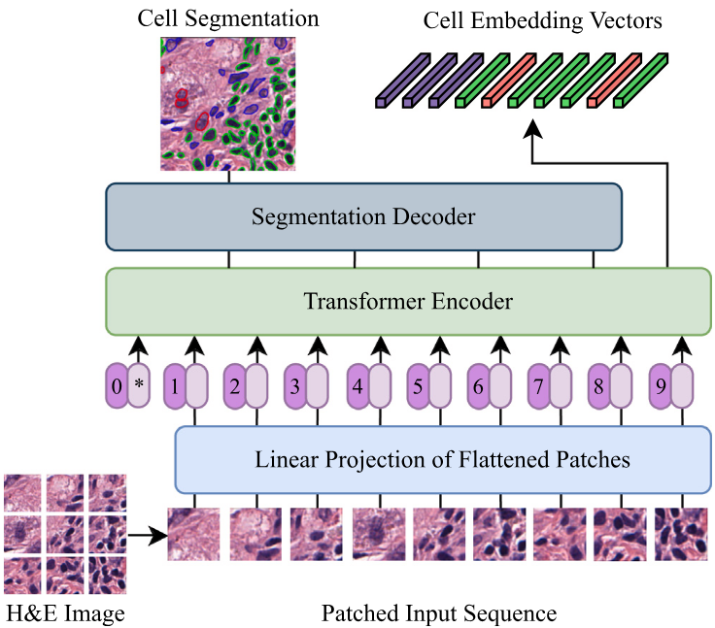
Adapting foundational vision models to instance segmentation and data quality assessment with few annotations: application in histopathology.
Instance segmentation with foundational models
Foundational model
Example of nuclei instance segmentation in pancreatic tissue. Ground truth in first row, prediction in second. Figure taken from [3].
Example of a SOTA instance segmentation technique in histopathology. The encoder is initialized with a foundational model. Figure taken from [3].
Individual instances of the same class ≠ semantic segmentation

Slide 5
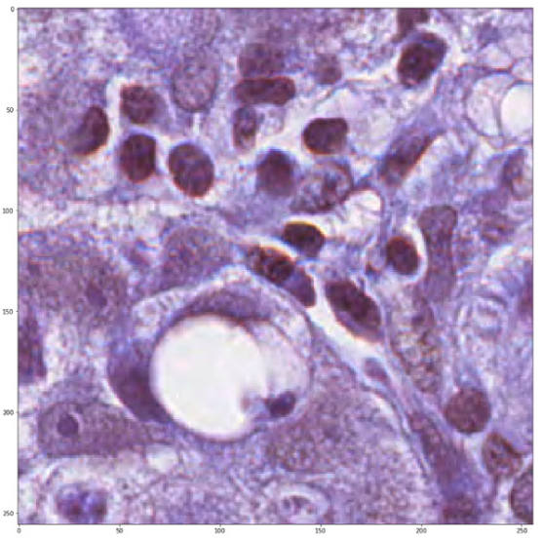
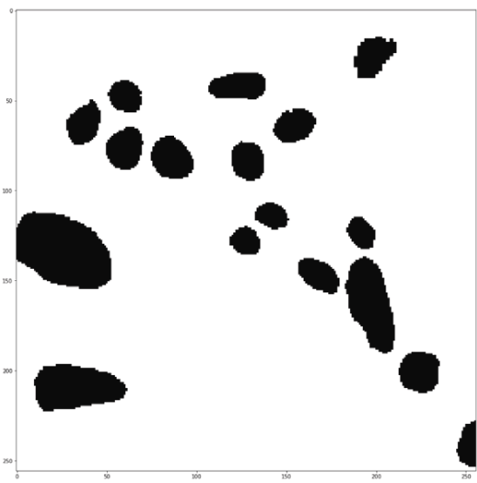
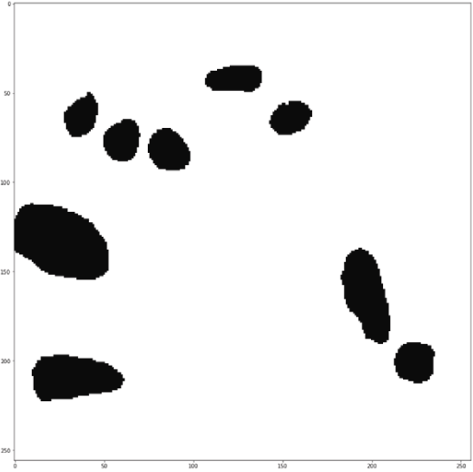
Adapting foundational vision models to instance segmentation and data quality assessment with few annotations: application in histopathology.
Data quality assessment
Raw Image
Correct annotation
Annotation with detection errors
Example of missing annotations in MoNuSAC, taken from [4]
Imperfect or missing annotations

Slide 6
Work Plan
WP1 – Framework implementation:
Casting all datasets to the same format
Instantiate adaptations methods with the foundational models missing from previous studies
WP2 - Instance Segmentation:
Fine-tune the models with the adaptation methods on all datasets for instance segmentation
Fine-tune the models with the adaptation methods on MoNuSAC (baseline and cleaned dataset) to detect missing or incorrect annotations
Eventually, add tricks to the adaptation methods for improved performances

Slide 7
Expertise Sought
Some experience with Python and PyTorch
Knowledge and skills in foundational models fine-tuning or instance segmentation are appreciated but not necessary

Slide 8
​Summer Workshop 25’ London
Thank you for your attention !

Slide 9
References
[1] https://en.wikipedia.org/wiki/Histopathology
[2] Chen, R. J., Chen, C., Li, Y., Chen, T. Y., Trister, A. D., Krishnan, R. G., & Mahmood, F. (2022). Scaling vision transformers to gigapixel images via hierarchical self-supervised learning. In Proceedings of the IEEE/CVF conference on computer vision and pattern recognition (pp. 16144-16155).
[3] Hörst, F., Rempe, M., Heine, L., Seibold, C., Keyl, J., Baldini, G., ... & Kleesiek, J. (2024). Cellvit: Vision transformers for precise cell segmentation and classification. Medical Image Analysis, 94, 103143.
[4] Jiménez, L. G., & Decaestecker, C. (2024). Impact of imperfect annotations on CNN training and performance for instance segmentation and classification in digital pathology. Computers in biology and medicine, 177, 108586.

Slide 10
Datasets
Lizard: https://www.kaggle.com/datasets/aadimator/lizard-dataset (495000 nuclei / Colon only).
PanNuke: https://huggingface.co/datasets/RationAI/PanNuke (205000 nuclei from different tissues).
NuCLS: https://sites.google.com/view/nucls/home (220000 nuclei / Breast only).
MoNuSac: https://monusac-2020.grand-challenge.org/ (46 000 nuclei from 37 centers and 71 patients).
ConSEP: https://paperswithcode.com/dataset/consep (41 1000 X 1000 images with instance annotations for 24 319 nuclei –– Colon only).
Ocelot: https://ocelot2023.grand-challenge.org/datasets/ (113 026 nuclei from 663 patches of size 1024 X 1024, 6 organs)
Panoptils: https://sites.google.com/view/panoptils/ (814 886 nuclei from 1709 patches, breast cancer)
PUMA: https://puma.grand-challenge.org/ (310 patches of size 1024 x 1024 with instance annotations, about 100 000 nuclei in total, 8 different organs)

Slide 11
​Summer Workshop 25’ London
If you need a table-of-contents slide
If you need a table-of-contents slide

