Slide 1
Annual Event 23 – Trustworthy AI
AI for Medicine
Benoit Macq - Prof (UCLouvain)
En collaboration avec
Avec le soutien de

Slide 2
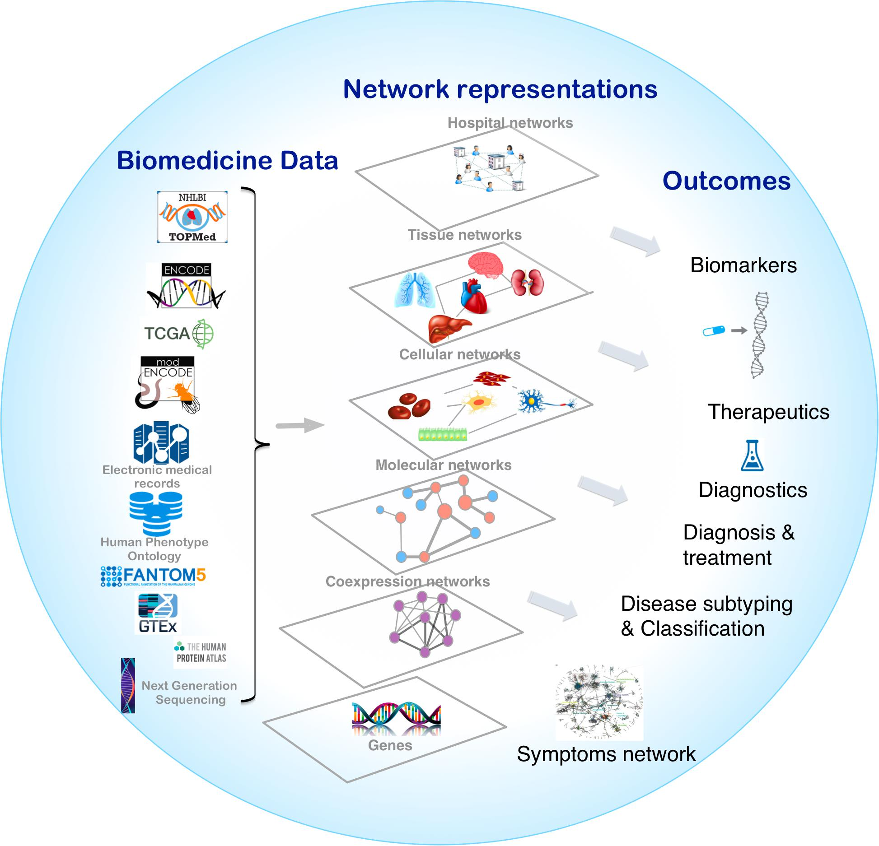
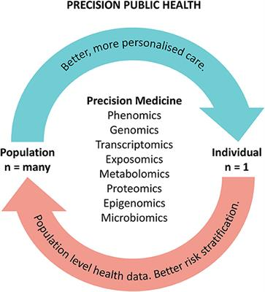
Deep Medicine and Network Medicine

Slide 3
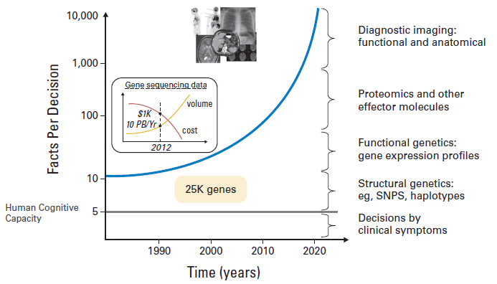
Facing high dimensionality in medicine
J Clin Oncol 2010;28:4268; JMI 2012 Friedman, Rigby; BMJ Clinical Evidence

Slide 4
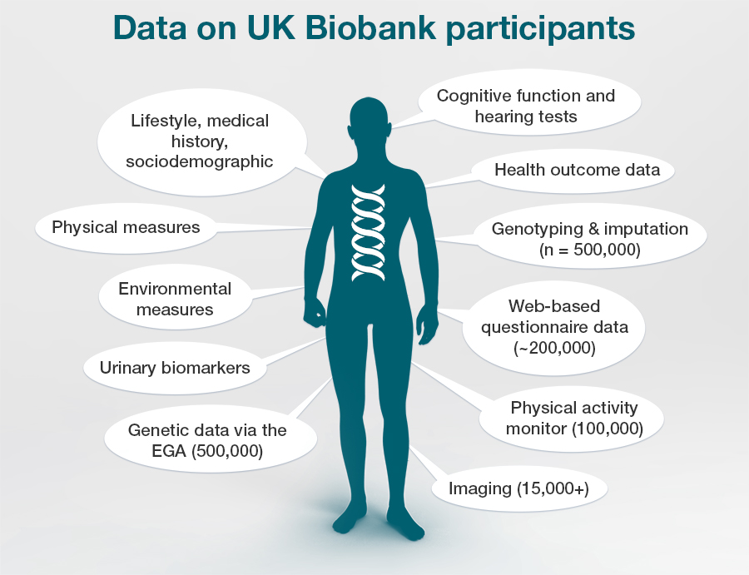
Benchmarks for Data driven medicine
Reducing by 30% health costs by better
screening, diagnosis, treatment, particpation +
4P medicine: prevent, predict, personalize, participate
-> Living better, not (necessarily) longer

Slide 5
Large data sets and AI in Network Medicine to:
Build better diagnoses and prognoses (predictors of disease development on the basis of observed biological data, useful for preventing and / or managing the disease)
Better understand the network of interactions specific to the patient that induces the disease –the pathogenesis (and therefore provide a better overall explanation to the patient to increase their participation)
Better personalize a treatment plan (the choice of a drug and / or a treatment plan will be adapted to the patient's specific network)
Include the patient in the choice of possible scenarios in a framework that respects privacy and respects patient values.

Slide 6
Issues
Over-reliance on models (skills decay ?)
Certified models vs lifelong learning (how to cope with science progresses ?)
Overdiagnosis (DNA polygenic risks)
Freedom to not know
Privacy vs Science
Consents

Slide 7
Coalitional Active Learning: MedReSyst
Continually improving clinical decisions for all entities
Continual training of human experts
Continual active learning of local and coalitional models

