Slide 1
Annual Event 23 – Trustworthy AI
AI and MEDIA (THE EXAMPLE OF THE METAVERSE)
Prof. T. Dutoit, UMONS
En collaboration avec
Avec le soutien de

Slide 2
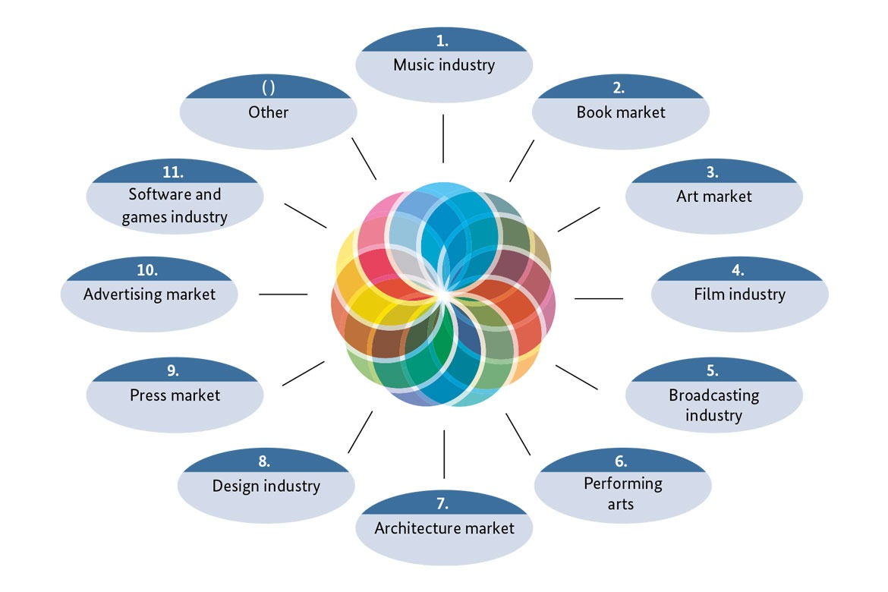
Cultural ad Creative Industries (CCIs) have been a driver for AI development
Source : https://www.bmwi.de/Redaktion/EN/Dossier/cultural-and-creative-industries.html

Slide 3
AI-assisted Creation/ Production/Distribution
Création
Production
Distribution
AI-assisted Creation
AI-assisted Production
AI-assisted Distribution/ Consumption

Slide 4
AI-assisted distribution/consumption of media content
Recommending content (Soc. Nets, Netflix, Spotify, etc.)
Providing customer service based on Intelligent Virtual Agents
Customizing content to audiences (translation, adaptation for people with disabilities, optimized flow status in video games, ads ☹)
Enhancing the liveliness of media content through collaborative experience
= « Metaverse »
= « Digital twins »
Oculus (Facebook-Meta), 2018

Slide 5
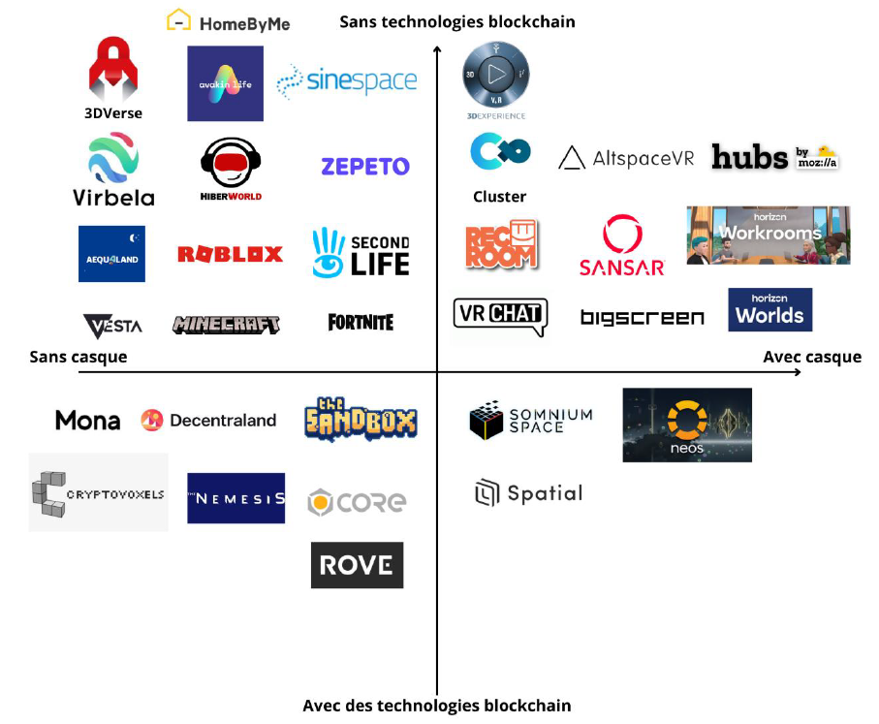
Metaverse ?
= 3D virtual worlds
Immersive (VR headset, screens)
Interactive (avatars, movements, gaze, voice, hands)
Persistent
(decentralized governance - blockchain)
(value creation - cryptocurrencies)
Source : « Mission exploratoire sur les métavers »
https://medias.vie-publique.fr/data_storage_s3/rapport/pdf/286878.pdf (octobre 2022)

Slide 6
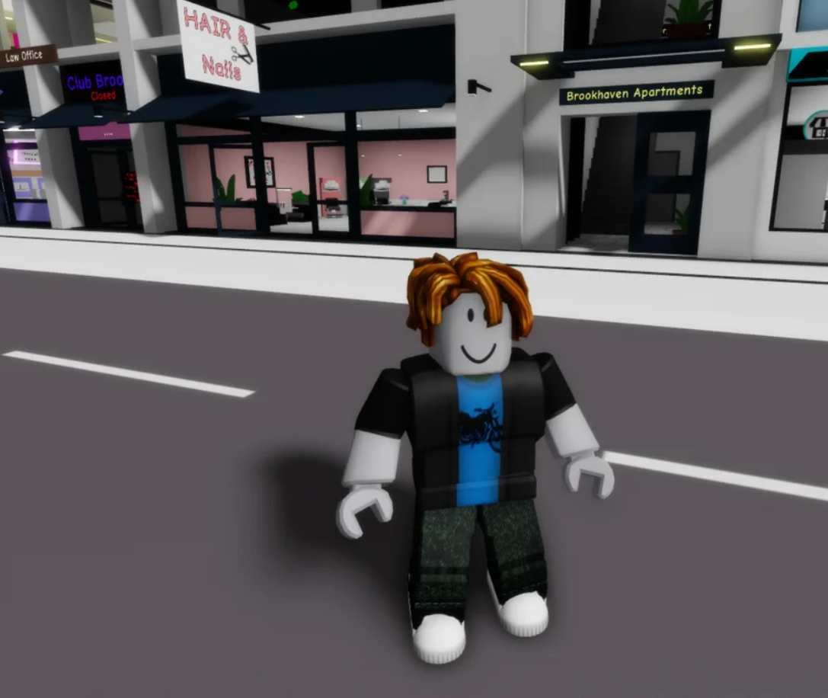
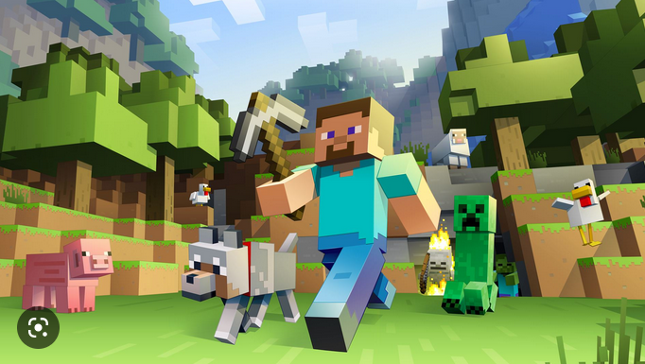
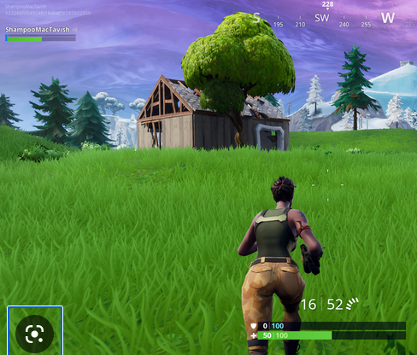
Video gaming in the Metaverse
Source : numerama
ROBLOX (2006) - 200 million users/month, of which 10 million developpers
MINECRAFT (2011)
FORTNITE (2017) - 400 millions users
Also a social place for gamers (using the metaverse platform for chatting)

Slide 7
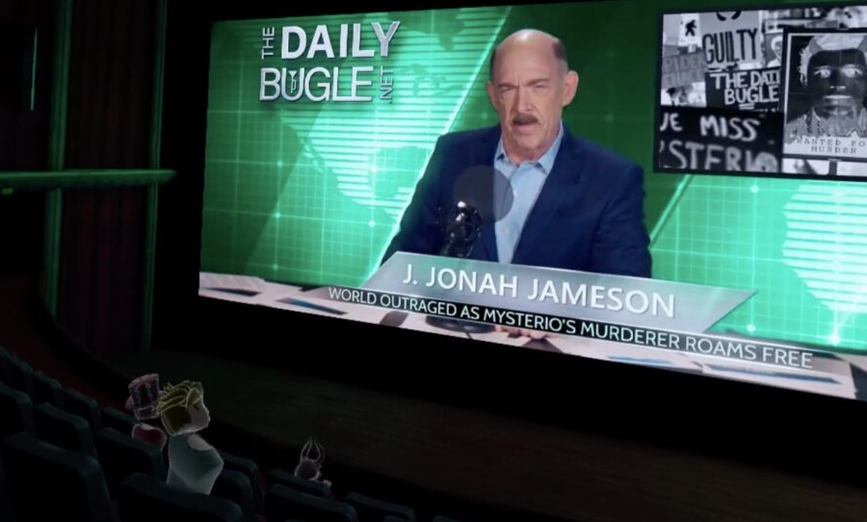
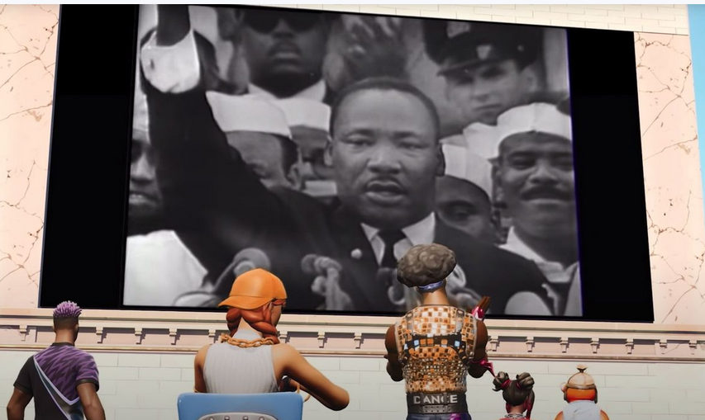
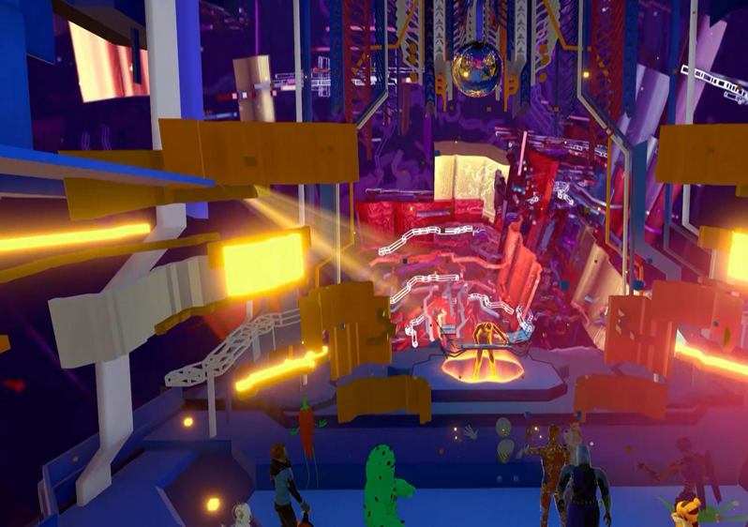
Culture in the Metaverse
Source : numerama
Meta Horizon Worlds/BigScreen : Create a room and stream your PC screen. Including audio exchanges between attendees. Ex : Watch a movie with remote family or friends
Watching a movie in FORTNITE
Virtuel concert of Jean-Michel Jarre in Notre Dame de Paris (2020), 600000 viewers by rooms of 50, replayed 75 million times – concert organized in VRChat by French SME VROOM

Slide 8
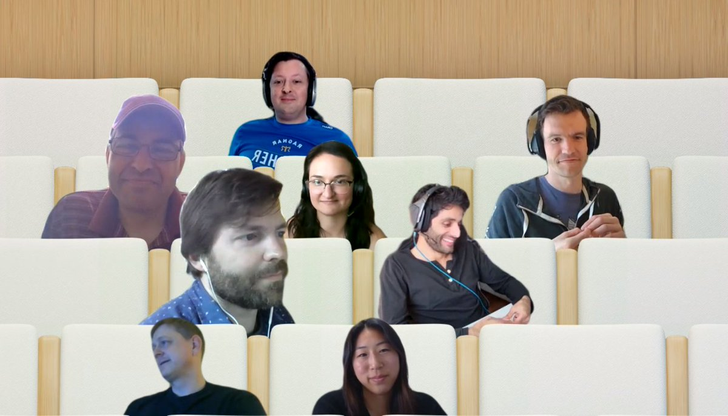
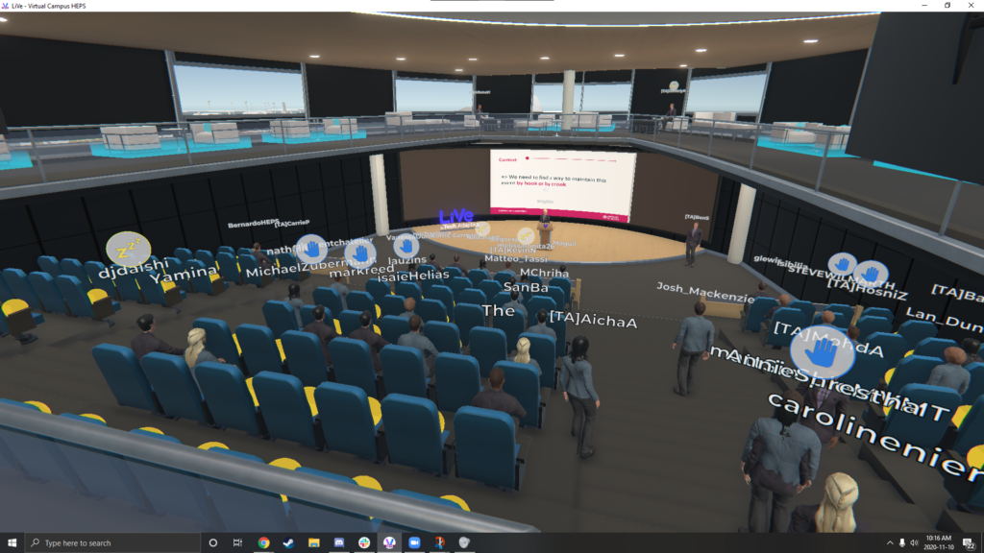
Teaching in the Metaverse
Teaching in Microsoft Teams
Teaching in the Metaverse

Slide 9
The Metaverse could be the new driver for AI development
2021 Facebook becomes Meta and invests 10 G$
2022 Meta creates Horizon Worlds, its metaverse platform
2022 : « winter » of the metaverse?
Head-mounted displays don’t sell enough
Generative AI explodes
2024-… IA+XR = summer of the metaverse?
Meta’s ARIA project (ICASSP’23) : A deluge of “egocentric” multimedia data is awaiting us…

Slide 10
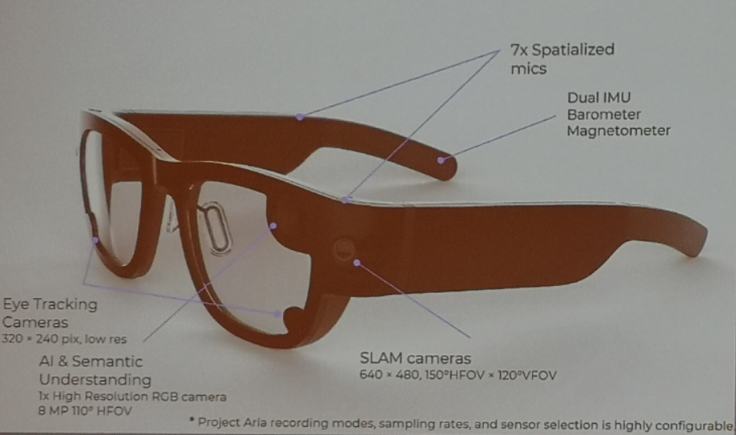
The Metaverse could be the new driver for AI development
2021 Facebook becomes Meta and invests 10 G$
2022 Meta creates Horizon Worlds, its metaverse platform
2022 : « winter » of the metaverse?
Head-mounted displays don’t sell enough (yet?)
Generative AI explodes
Meta fires
2024-… IA+XR = summer of the metaverse?
Meta’s ARIA project (ICASSP’23) : A deluge of “egocentric” multimedia data is awaiting us…

Slide 11
The Metaverse could be the new driver for AI development
→MORE DNNs →BIGGER Data →Faster GPUs

Slide 12
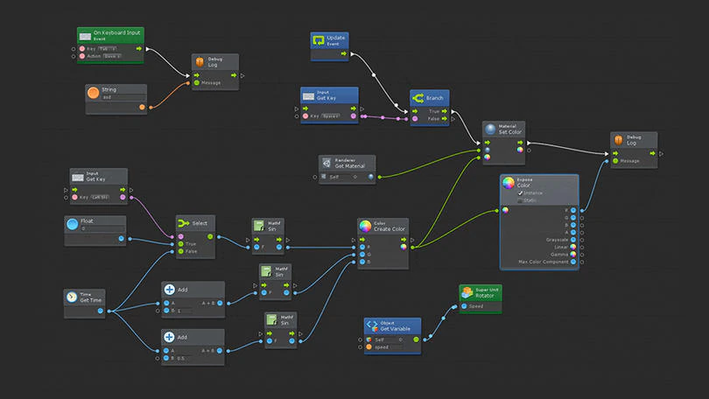
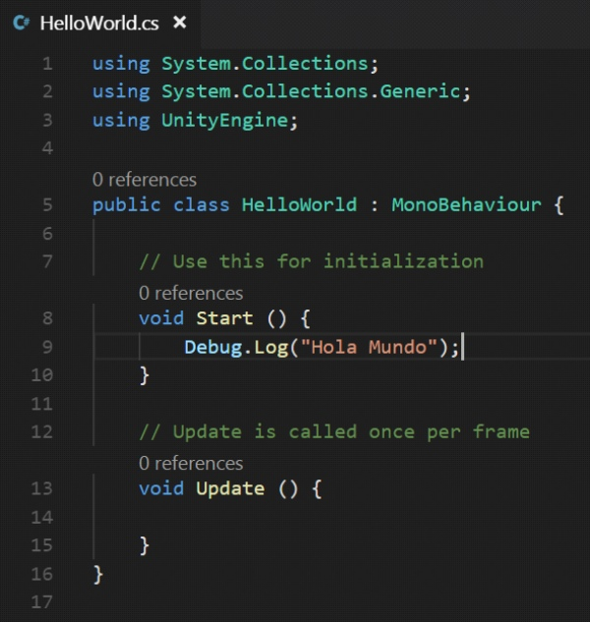
AI could be the new driver for the development of the Metaverse

Slide 13
AI + Metaverse = virtuous or vicious circle?
New perspectives in remote immersive communication
Useful for education
Essential
to face increased risk of pandemics?
to reduce CO2 emissions due to physical travel

Slide 14
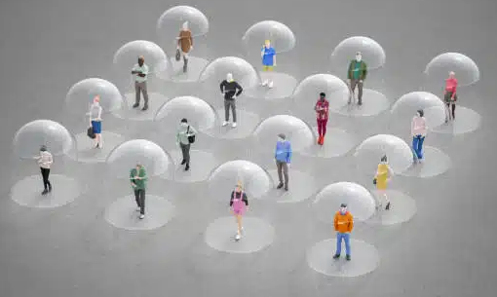
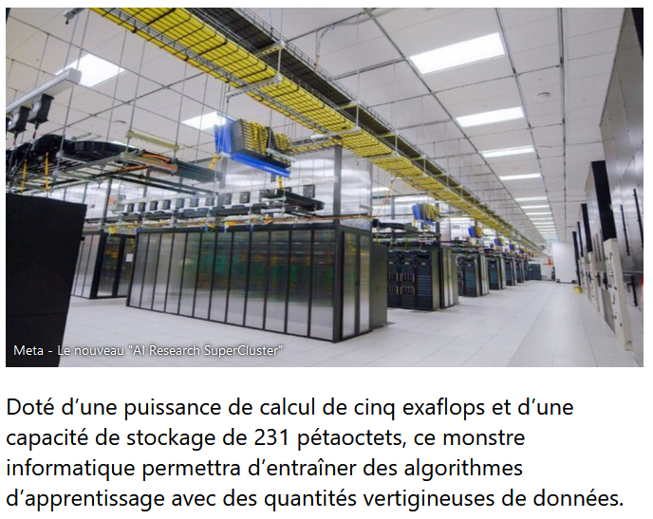
AI + Metaverse = virtuous or vicious circle?
"People are even dumber in the metaverse than in reality" (anonymity, spontaneity). Physical-virtual" or verbal aggression. (see META's "security bubble")
Security breaches in our private lives (access to our voices, movements, actions) – cf. AI Act!
Increased privatization of social exchange platforms
Real environmental impact of metaverse and their computer servers?
5 Exaflops and 231 PetaBytes : this is Meta’s latest supercomputer for training AI with the forthcoming data deluge

