Slide 1
Annual Event 23 – Trustworthy AI
AI Powered Marketing: How to Protect Consumers?
Anne-Lise Sibony – EU Law Prof Diana Mocanu (PhD Student)
(UCLouvain)
En collaboration avec
Avec le soutien de

Slide 2
Notes:
Personalisation is not new
Carpet seller will
show / not show certain carpets
announce different prices
lay out options differently (by inviting consumers to compare carpet A, B then ABC – or A and B, then B and C.
Such practices are not generally considered unfair

Slide 3
AI-Powered Personalisation
Use of AI: leap in scale and sophistication
Exploitation of biases prevalent in a group of consumers

Slide 4
Profiling
Mass production of ‘persuasion profiles’ (‘digital twins’)
Profiling based on
Web usage mining
Data collected from smart sensors
Allows automated personalisation of
Ads
Recommendations
Decision environments
Prices
Notes:
all aspects of human life are contained in these profiles, from shopping, food, and entertainment preferences to networks of friends, relationships, other aspects of social life, health, physical movements, driving hab- bits or sports-related activities.
behavioural biometric profiling: the profiles are inferred from data collected by sophisticated sensor technologies that record, store and aggregate machine-readable data about behaviours like speech, facial expression, key-stroke, gait, gesture, voice and handwritten signatures, blood pressure, heart rate or sleeping patterns.

Slide 5
Personalised ads
E.g. particularly myopic consumers see
very salient upfront ‘free’ offer (mobile phone)
and some important details of the phone plan are 3 clicks away
Consumers with low financial literacy see ad for investment in cryptocurrency
Potential to favour harmful transactions

Slide 6
Personalised prices
Ticket more expensive if data indicates high readiness to pay
Apple computer
Consumer browsing history about destination
Combined tiny cues

Slide 8
Data Harvesting
Initial focus: How data can be collected (GDPR)
Dark patterns affecting privacy settings are illegal (Decision against Meta, 2022)
But enforcement slow and fines low
Shift: Who can use what data (DMA, DSA)
Asymmetric obligations: very large platforms subject to stricter rules
Use of certain (sensitive) data is restricted
Notes:
Fine: max 4% of annual turnover but fine imposed to Meta closer to 0,3%

Slide 9
Data Usage
Personalisation must be transparent (always)
Disclosure of ‘main parameters’ which lead to ranking of offers (Consumer rights directive)/ targeting of ads (DSA)
Give (some) control over personalisation settings (ads, recommendations (DSA)
Mandatory only for VLOPs, if the platform chooses to offer options
Notes:
The incentives to offer the option to choose less accurate ad personalisation are unclear. They could grow if consumers become more demanding, and low personalisation appears necessary to gain, keep or regain consumers’ trust.

Slide 10
Examples
VLOP chooses to offer several levels of personalisation
It must give clear info and allow users to change personalisation settings
Ad personalisation
Personalisation based on browsing behaviour
Personalisation based on browsing behaviour + social media activity
Recommender systems
Recommendations based on browsing behaviour
Recommendations based on browsing behaviour + social media activity
No recommendation based on profiling

Slide 11
Legal perspective (3) Data pooling
New defaults for Gatekeepers (e.g. Google)
No combining of personal data that was acquired during the operation of the “core platform” (e.g. Google search) with personal data obtained from other services offered by the same provider (e.g. YouTube) …
… Unless user explicitly consents
Aim: level playing field for competitors but could protect consumers
…if not circumvented through
Degradation of service for those who choose blury profiling
Dark patterns to extract consent to granular profiling

Slide 12
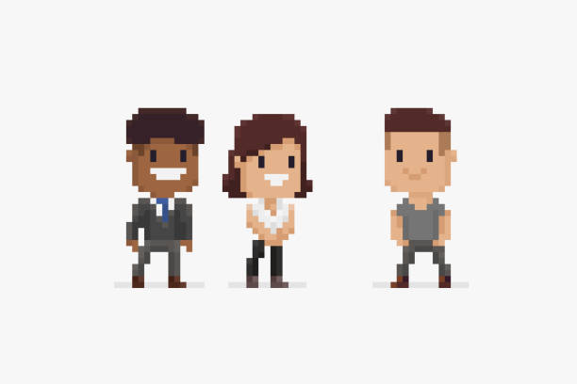
Wrap up
New provisions create a right to a more pixelated digital portrait.
If exercised (against VLOPs), could lead to less accurate personalisation
… at least until smaller platforms catch up and legitimately acquire enough data to produce digital twins made in Europe

Slide 13
anne-lise.sibony@uclouvain.be

